Slide 1

Cybersecurity and AI: A Data Science Perspective
Hsinchun Chen, Ph. D.
Regents’ Professor, Thomas R. Brown Chair
Director, Artificial Intelligence Lab (30th Anniversary)
Fellow, ACM, IEEE, AAAS
University of Arizona
Funding Acknowledgements: NSF, DOJ, DHS, DOD
AI Lab Alum: Ahmed Abbasi (UV), Victor Benjamin (ASU), Weifeng Li (UG), Sagar Samtani (USF)

Slide 2
Outline
Security Informatics & Analytics: COPLINK, BorderSafe, Dark Web
Cybersecurity & AI: AZSecure for Advanced Cyber Threat Intelligence

Slide 3
Computational Design Science in MIS (AI Lab/UA): ➔High-impact Societal (data/IT) Problems ➔Mathematics/Statistics/Linguistics/Cognition ➔ Algorithms/Representations (e.g., intelligent IR/SE, SOM, text mining, multilingual stylometric/affect/sentiment analysis, HCI/Viz, LDA, Deep Learning) ➔ Programs/Systems ➔ Evaluation/Adoption/Deployment ➔ Societal Impact

Slide 4
Security Informatics & Analytics

Slide 5
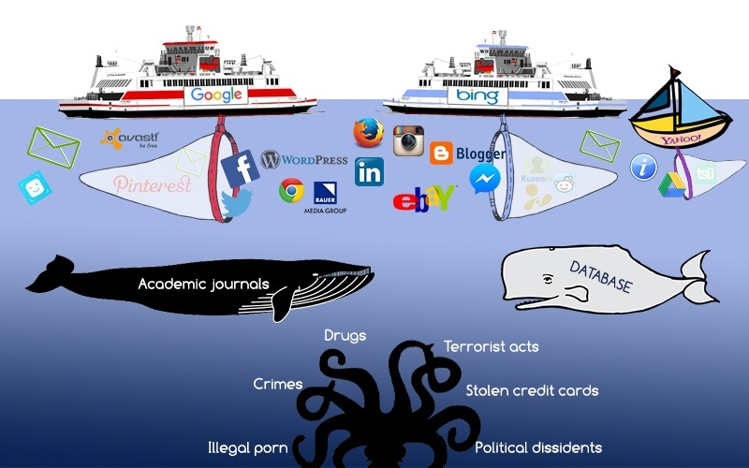
Surface Web
Deep Web
Dark Web
DarkNet
Hacker Web

Slide 6
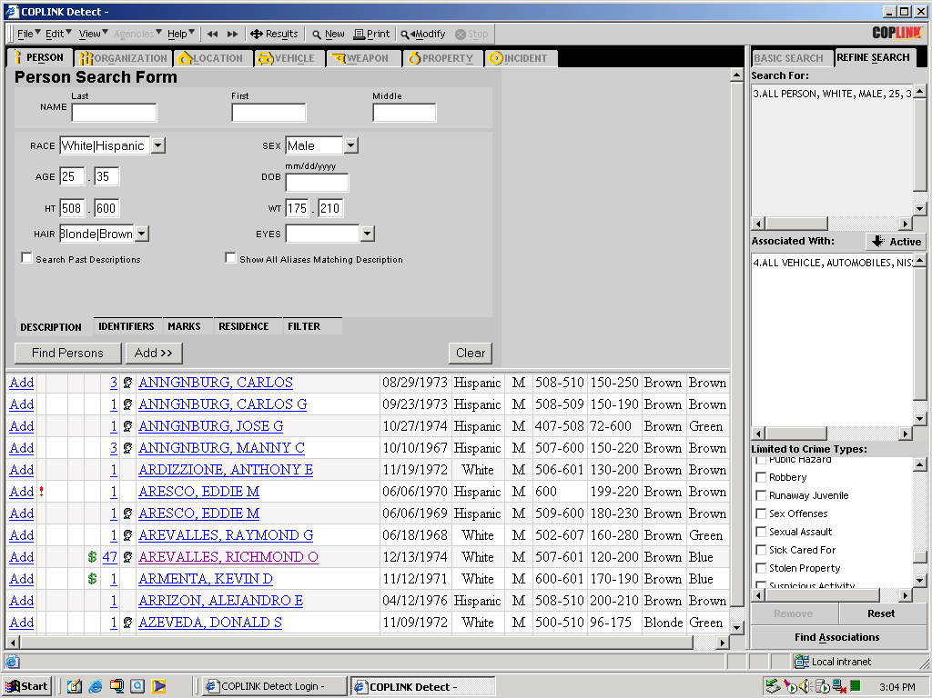
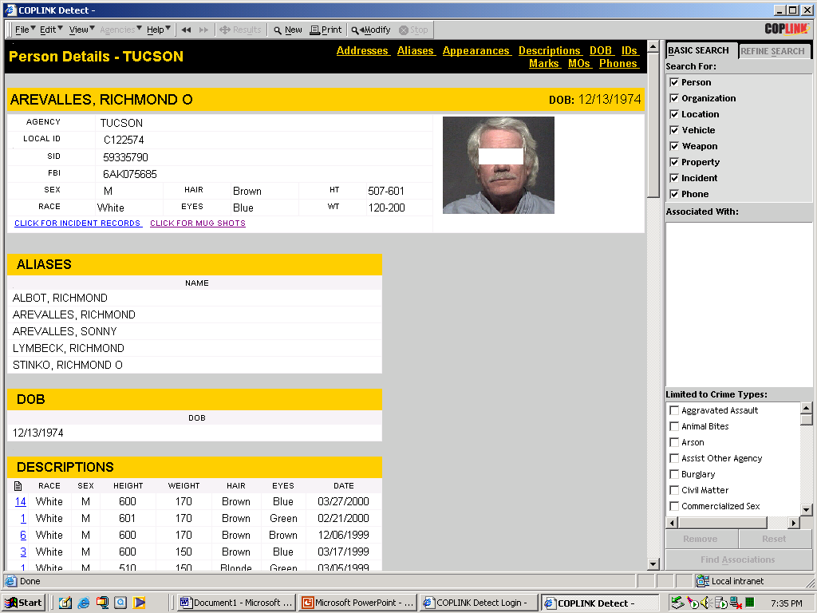
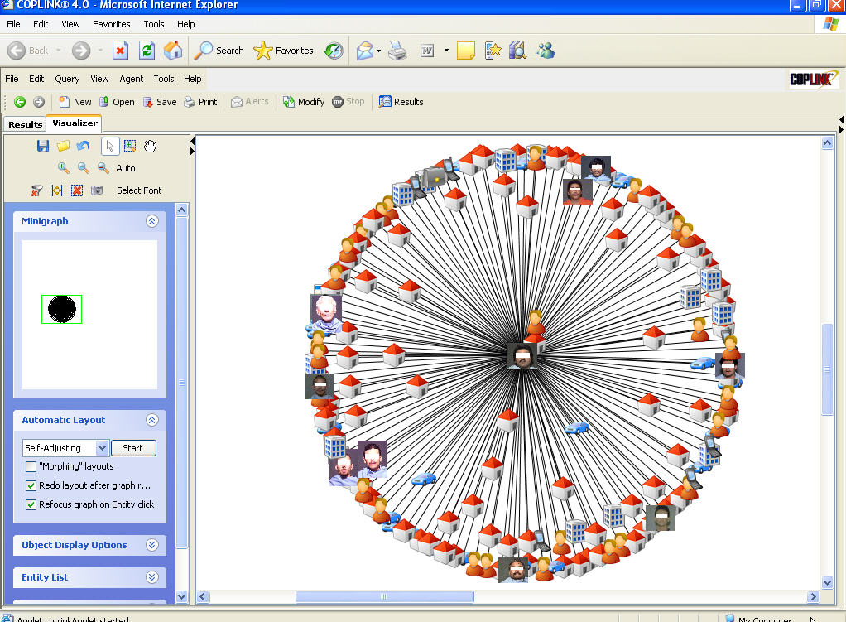
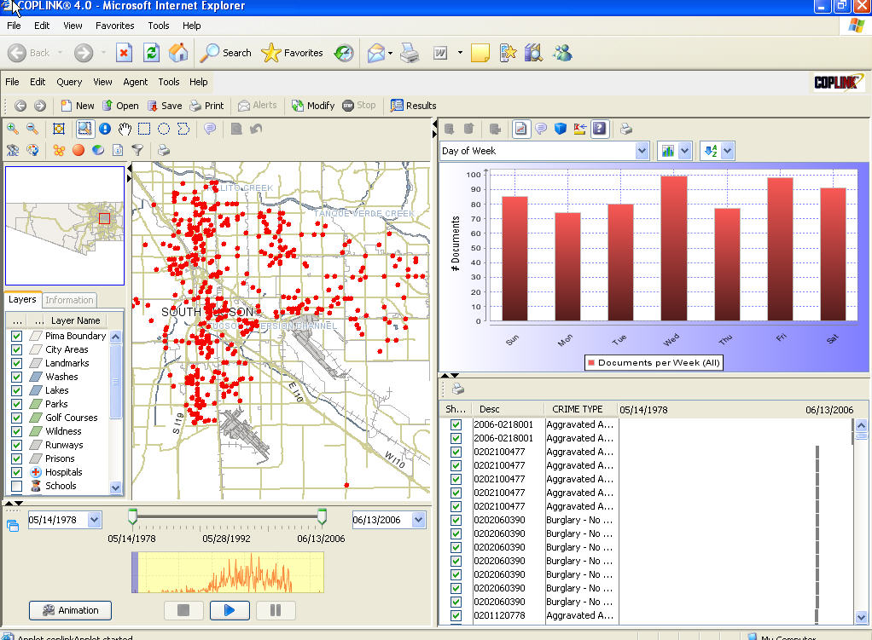
COPLINK: Crime Information Sharing & Data Mining

Slide 7
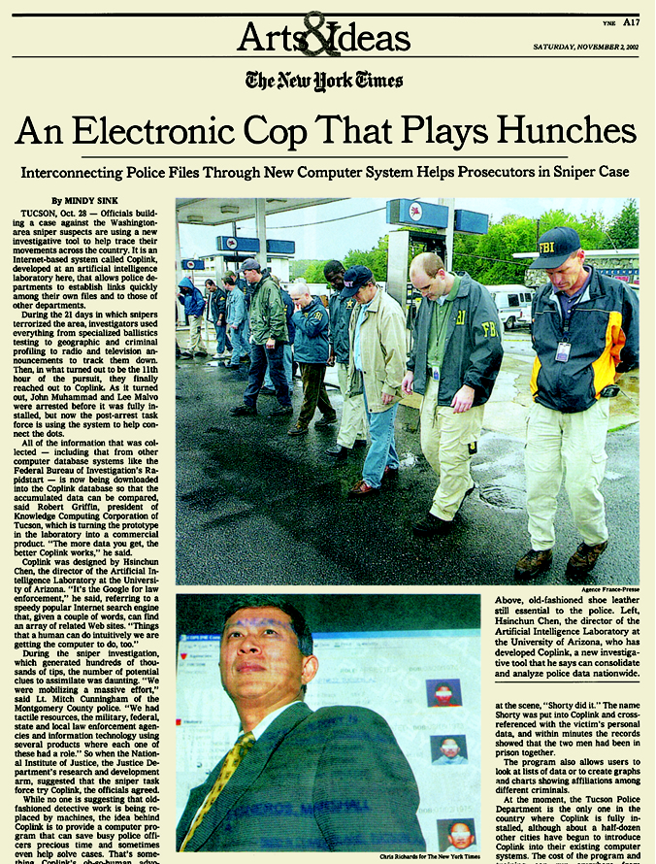




COPLINK: Crime Data Mining
The New York Times, November 2, 2002
COPLINK assisted in DC sniper investigation
ABC News April 15, 2003
Google for Cops: Coplink software helps police search for cyber clues to bust criminals
Washington Post, March 6, 2008
National dragnet is a click away! COPLINK in use in 3,500 police agencies in US!
Merged i2 in 2009; acquired by IBM in 2011 for $500M
($21B, IT unicorn, 2018)

Slide 8

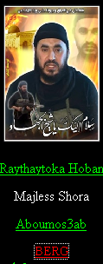

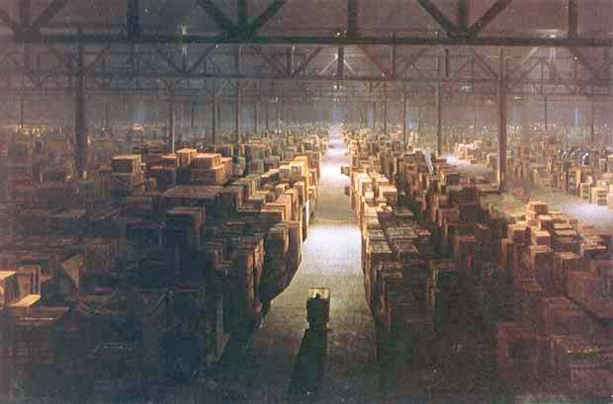
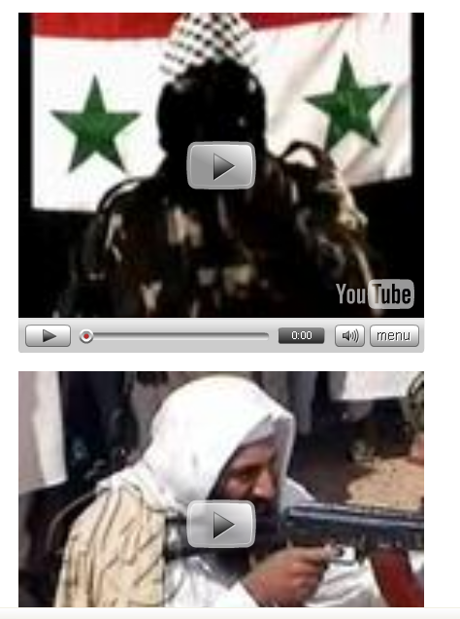
Dark Web Overview
Dark Web: Terrorists’ and cyber criminals’ use of the Internet
Collection: Web sites, forums, blogs, YouTube, etc.
20 TBs in size, with close to 10B pages/files/messages (the entire LOC collection: 15 TBs)

Slide 9
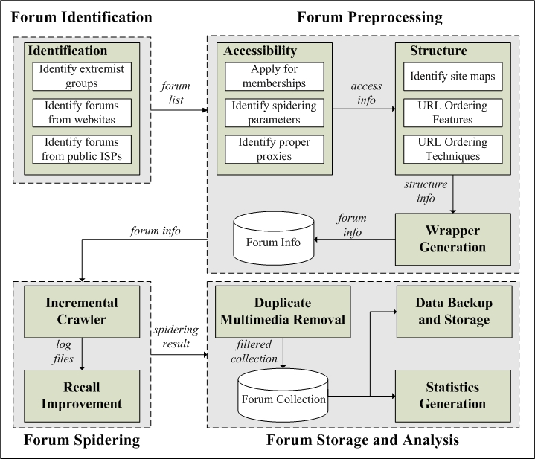
Dark Web Forum Crawler System: Probing the Hidden Web

Slide 10
CyberGate for Social Media Analytics: Ideational, Textual and Interpersonal Information

Slide 11
Arabic Writeprint Feature Set: Online Authorship Analysis

Slide 12
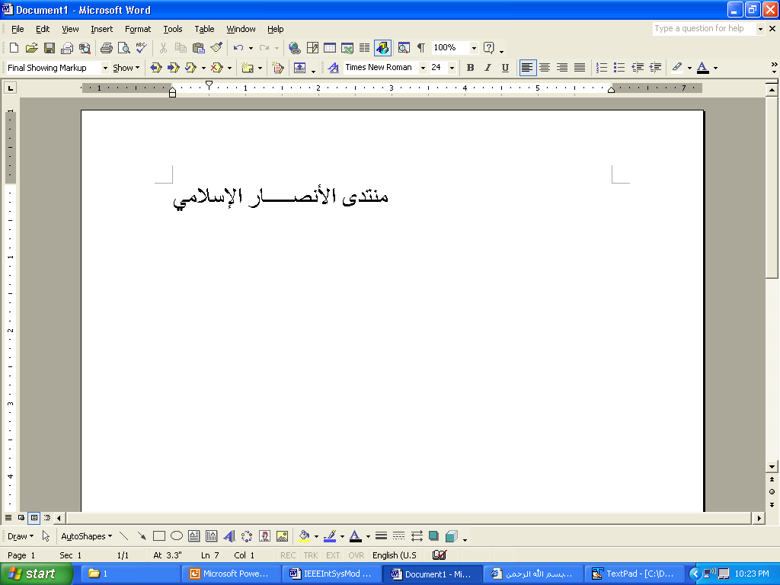

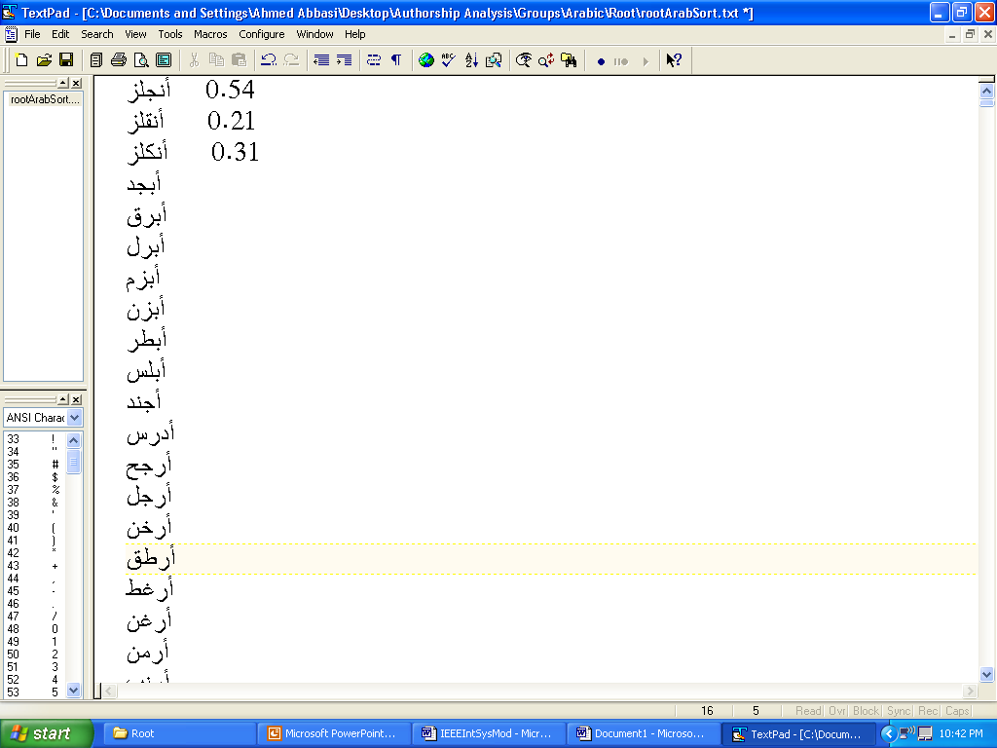
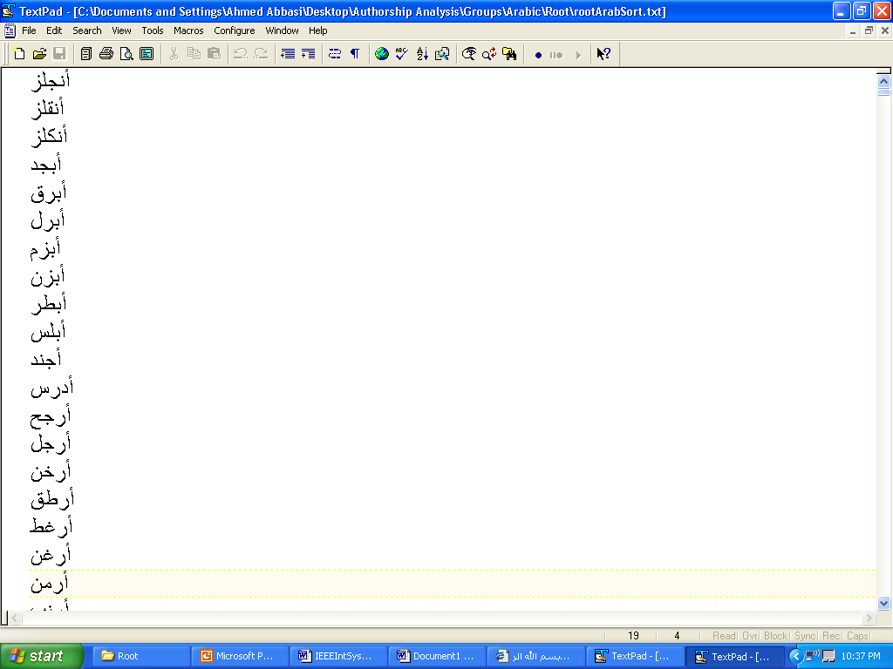
Arabic Feature Extraction Component
1
Incoming Message
Count +1
Degree + 5
2
Elongation Filter
Filtered Message
Similarity Scores (SC)
Root Dictionary
3
Root Clustering Algorithm
max(SC)+1
All Remaining Features Values
Generic Feature Extractor
4

Slide 13
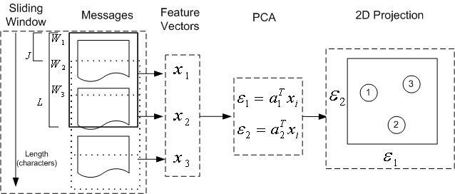
CyberGate System Design: Writeprints

Slide 14
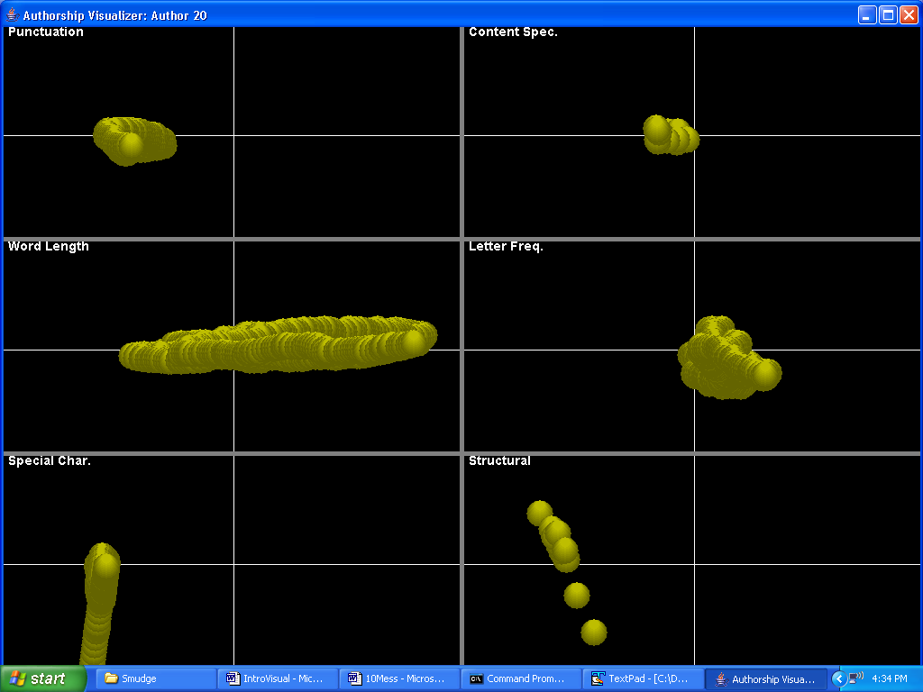
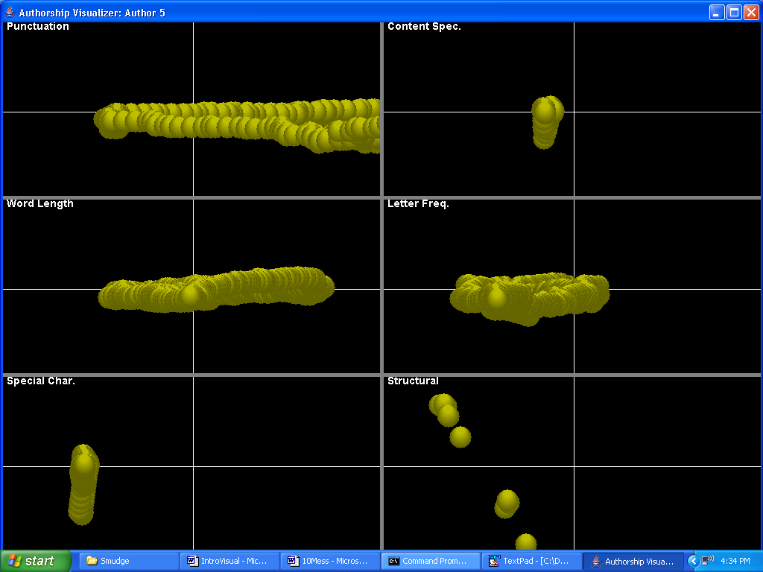
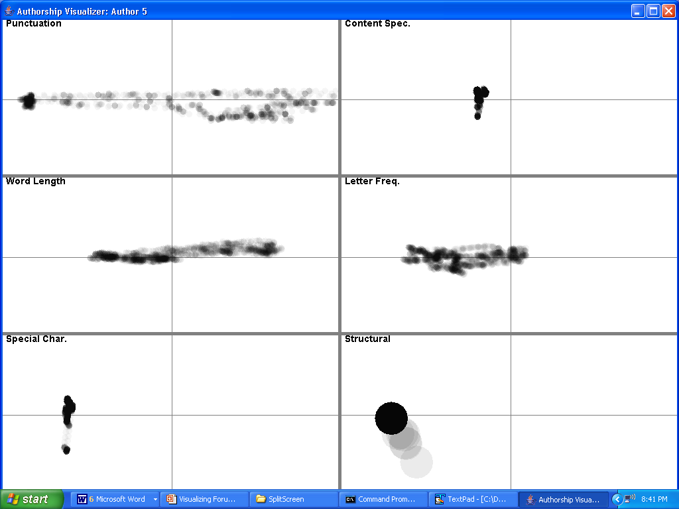
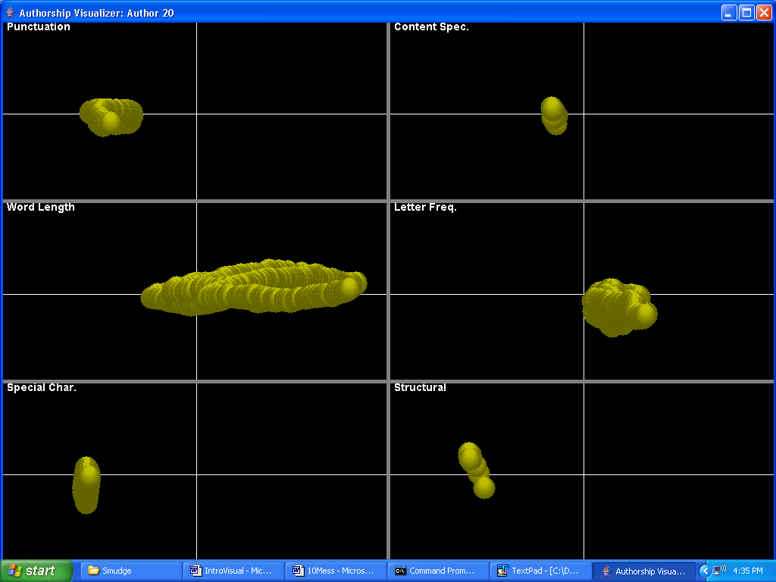
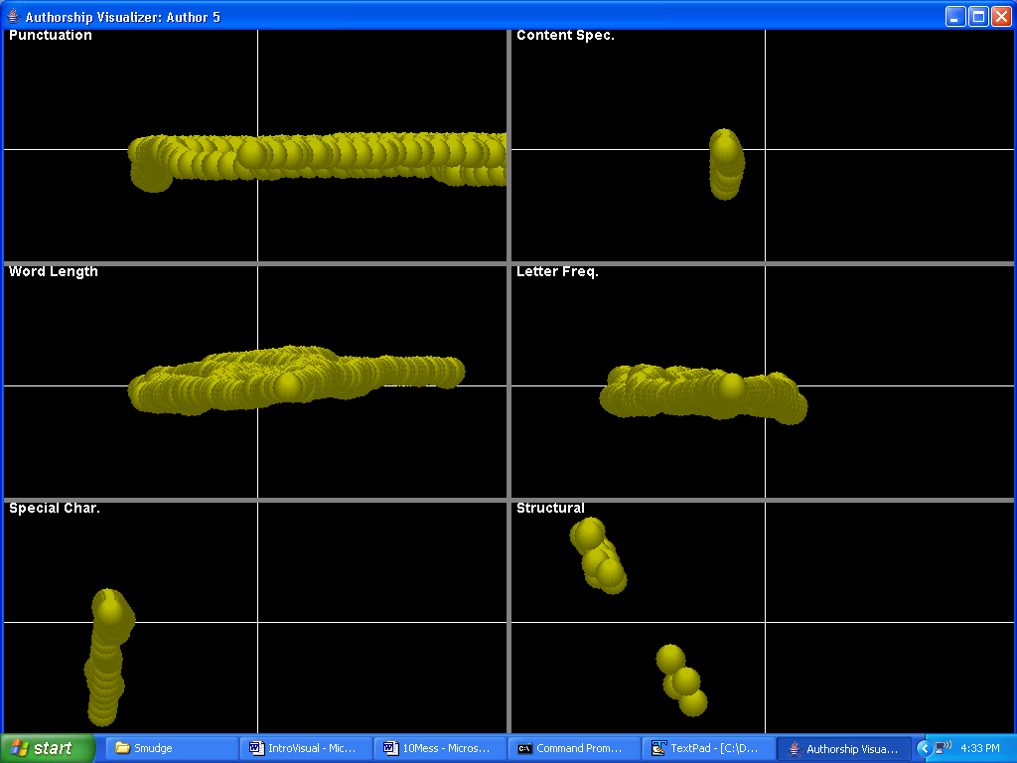
Author Writeprints
Anonymous Messages
Author A
10 messages
Author B
10 messages

Slide 15
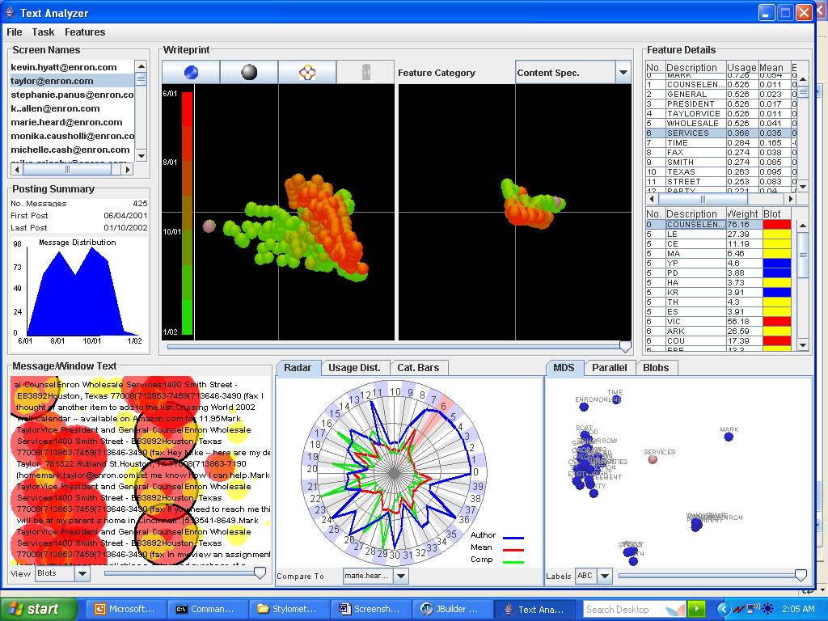
CyberGate (Abbasi, et al., MISQ, 2008) ➔ AZ PhishMonger (Abbasi, et al., MISQ 2010, best paper)

Slide 16



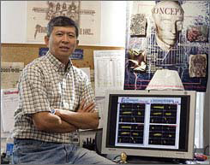
The Dark Web project in the Press
Project Seeks to Track Terror Web Posts, 11/11/2007
Researchers say tool could trace online posts to terrorists, 11/11/2007
Mathematicians Work to Help Track Terrorist Activity, 9/14/2007
Team from the University of Arizona identifies and tracks terrorists on the Web, 9/10/2007

Slide 17

ISI, Springer, 2006
Intelligence and Security Informatics (ISI) (Chen, 2006)
Data, text, and web mining
From COPLINK to Dark Web
IEEE ISI, EISIC, PAISI ➔ 4000+ scholars, since 2003

Slide 18
Dark Web, Springer, 2012
22 chapters, 451 pages, 150 illustrations (81 in color); Springer Integrated Series in Information Systems, 2012.
Selected TOC:
Forum Spidering
Link and Content Analysis
Dark Network Analysis
Interactional Coherence Analysis
Dark Web Attribution System
Authorship Analysis
Sentiment Analysis
Affect Analysis
CyberGate Visualization
Dark Web Forum Portal
Case Studies: Jihadi Video Analysis, Extremist YouTube Videos, IEDs, WMDs, Women’s Forums

Slide 19
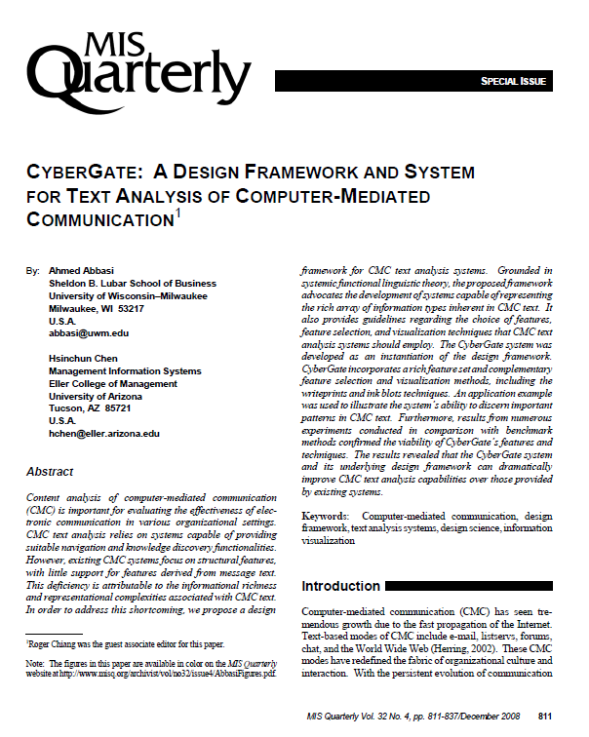
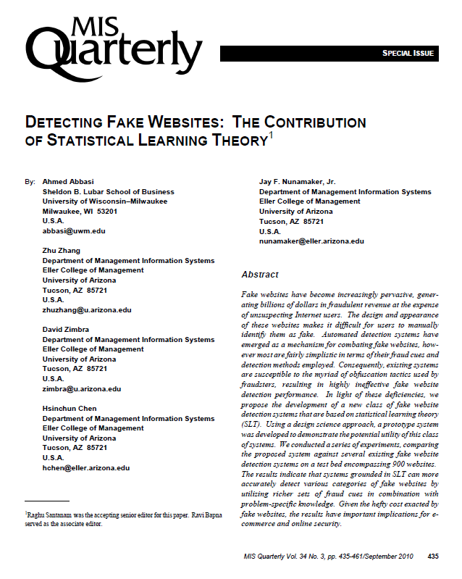

Slide 20
Cybersecurity & AI

Slide 21


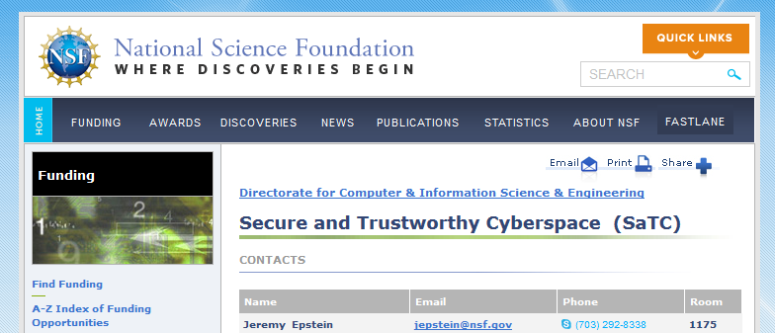
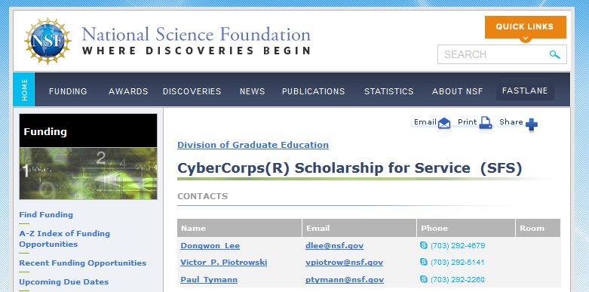

Slide 22
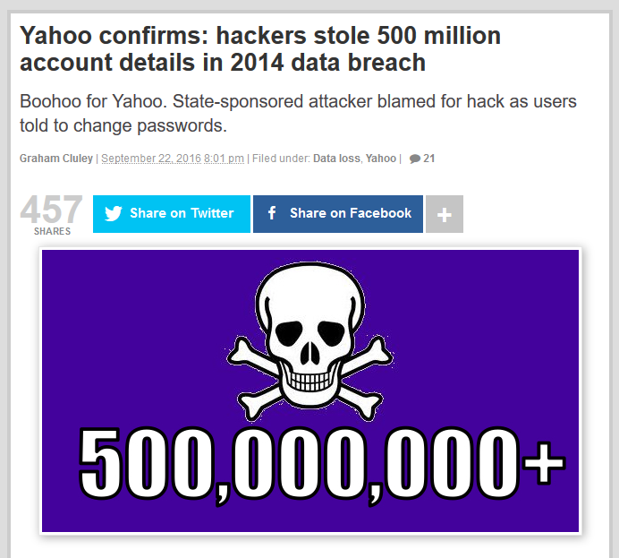
Selected data breach incidents in 2014
Victim | Date | Ramification
Target | 2013.12 | 40M credit/debit cards; 70M customer records; 46% drop in annual profits
Neiman Marcus | 2014.3 | 282K credit/debit cards
Sally Beauty | 2014.3 | 25K credit/debit cards
P.F. Chang | 2014.6 | 8 month of customer data from 33 stores
J.P. Morgan Chase | 2014.8 | 83M accounts
UPS | 2014.8 | 51 stores customers
Dairy Queen | 2014.9 | 395 store systems
Home Depot | 2014.9 | 56M credit/debit cards
Jimmy Jones | 2014.9 | 216 store systems
Staples | 2014.10 | 51 store systems
Are your data breached? Do you even know?
Notes:
references

Slide 23




Cyber Threat Intelligence: From Reactive/Internal to Proactive/OSINT
However, a recent EY CTI report noted:
“Cyber threats are increasing…”
FireEye + Mandiant + iSight
“Organizations need to take a more proactive approach to cybersecurity.” and

Slide 24
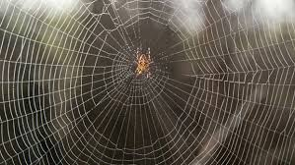

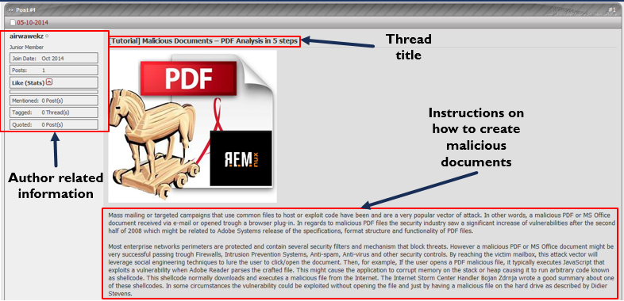
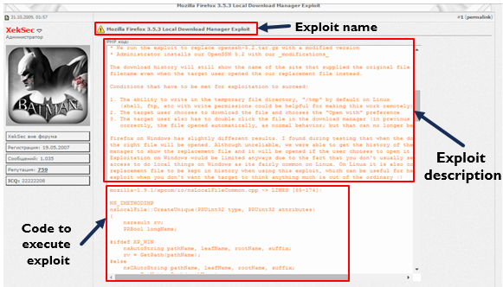
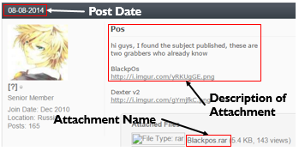

Hackers and Hacker Assets
Tutorial on how to create
malicious documents
Forum post with source code to
exploit Mozilla Firefox 3.5.3
Forum post with
BlackPOS malware attachment.

Slide 25

AI & Deep Learning:
In “Nature” 27 January 2016:
“DeepMind’s program AlphaGo beat Fan Hui, the European Go champion, five times out of five in tournament conditions...”
“…AlphaGo program applied deep learning in neural networks (convolutional NN) — brain-inspired programs in which connections between layers of simulated neurons are strengthened through examples and experience.”

Slide 26
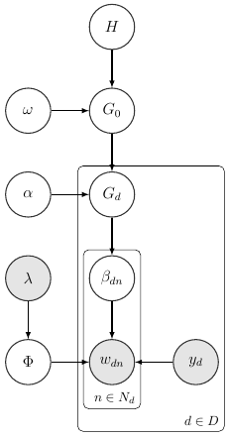
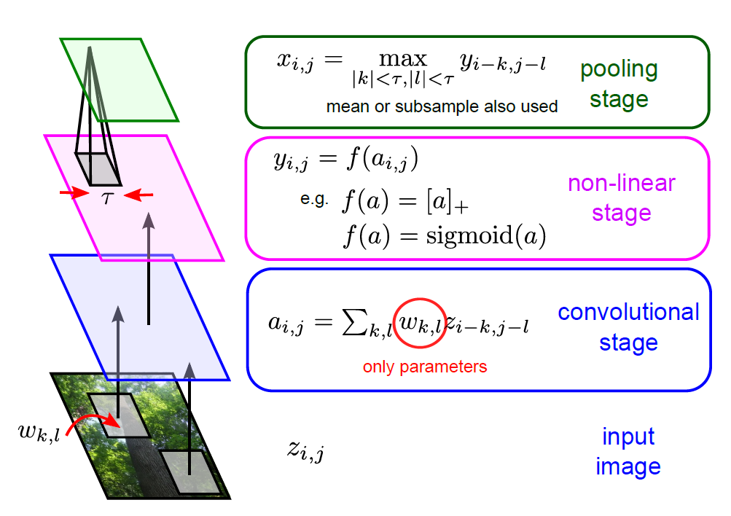
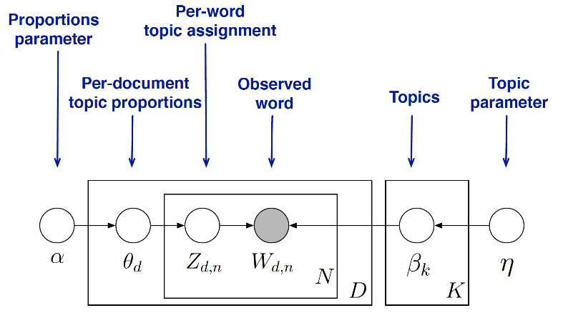
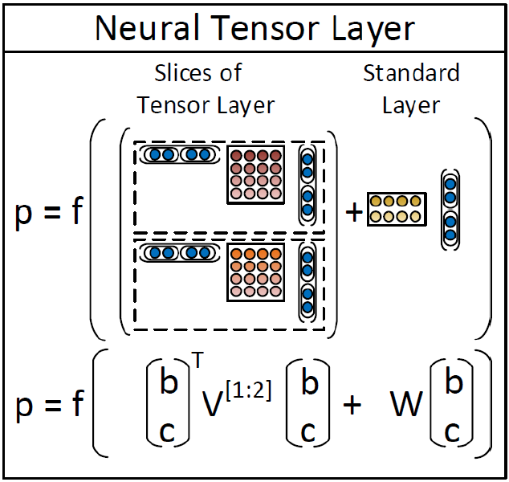
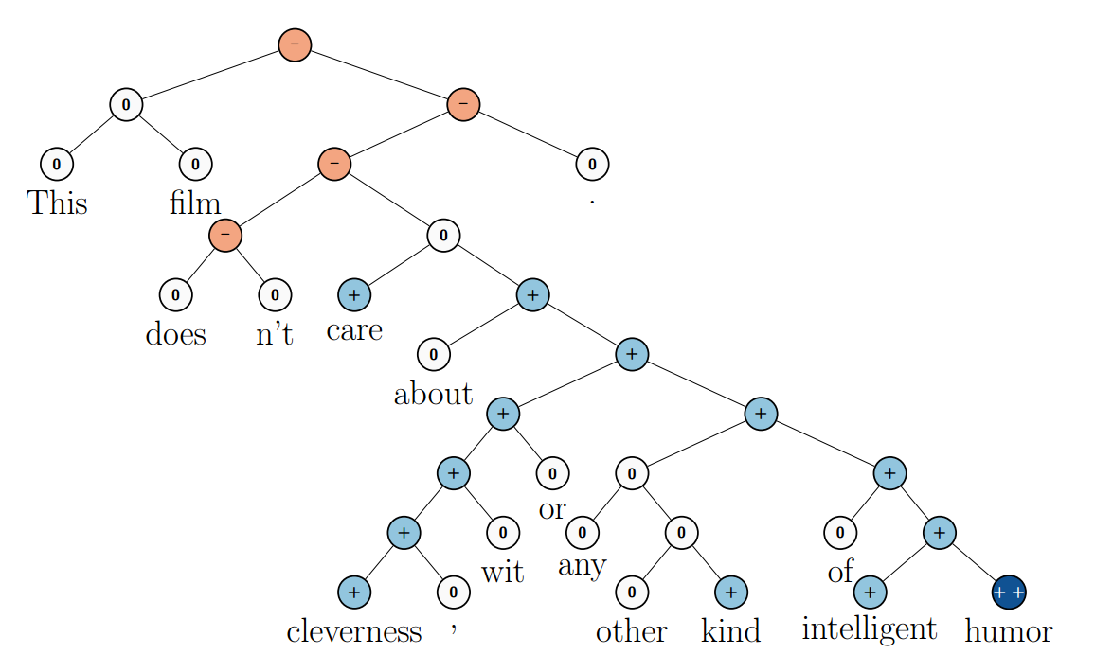
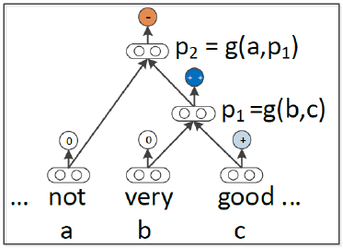

AzSecure Data/Text/Web Mining Methodologies: From Deep Learning to Topic Modeling
Hierarchical Dirichlet Process-based Inverse Regression Model (HDPIR)
Deep (Convolutional) Neural Net
Latent Dirichlet Allocation (LDA)
Compositionality function
Recursive Neural Tensor Network: Word2Vec
Example feedback: “The dump is not very good”
Notes:
CLCTN: extract ads of diff type→who’s selling what
ANAL: ID and profile
TR: gen inclusive subset of UE threads and rule out irrelevant threads→classification efficiency
TC: dethermine if ad, what prod/serv; MaxEnt (Y?); features
SR: eval seller measuring CF
TSP: seller char TOPM
The framework comprises two steps: the collection step and the analytics step.
The collection step extracts advertisements and group them based on the product/type. It has two components: (1) thread retrieval and (2) thread classification.
(mouse) From a comprehensive collection of hacker forum discussions, thread retrieval identifies a subset of threads involving hacker forum users interested in the underground economy topics.
(mouse) The threads are classified to determine whether they are advertisement threads or not, and more specifically, if they are advertisement threads, what product/service they are promoting.
The analytics step analyzes the advertisements as well as associated customer feedback to evaluate and profile the seller. It has two components: (3) seller rating and (4) top seller profiling.
(mouse) Given advertisements of different categories of products/services, we can identify the specialty of the sellers and further evaluate their quality. Sellers are rated separately based on the replies to the thread.
(mouse) Top rated sellers are then profiled using topic modeling approach.
Given the significance of malware seller and stolen data seller, the scope of the research focuses on these two groups of sellers. Nonetheless, our framework is generalizable to capture sellers with other specialties.
In the reminder of this section, we elaborate each component in the framework.

Slide 27
Research Background – CTI Process
Phase 1: Intelligence Planning/Strategy
Description: Identify intelligence needs of organization, critical assets, and their vulnerabilities
Phase 2: Data Collection and Aggregation
Description: Identify and collect relevant data for threat analytics
Data sources: internal network data, external threat feeds, OSINT, human intelligence
Phase 3: Threat Analytics
Description: Analyze collected data to develop relevant, timely, and actionable intelligence
Approaches: malware analysis, event correlation, visualizations
Phase 4: Intelligence Usage and Dissemination
Approaches: manual and automated threat responses, intelligence communication standards (e.g., STIX)
Description: Mitigate threats and disseminate intelligence
Approaches: threat trending, vulnerability assessments, asset discovery, diamond modelling
Criticism: Reliance on past events → reactive intel
Criticism: Analytics are too high level
Prevailing CTI process has been criticized as reactive and high-level (Lee and Lee 2017).
Thus, cyber-attacks are still increasing.
Need a shift from reactive to proactive CTI approaches.
Expert suggestion: Proactively pinpoint key hackers in online hacker communities.

Slide 28
Hacker Community Platforms – “Know your enemy”
Hacker Forums
Discussion board allowing hackers to freely share malicious tools and knowledge
DarkNet Markets
Markets facilitating the sale of illicit goods (e.g., new exploits, drugs, weapons)
Carding Shops
Shops selling sensitive information (e.g., credit cards, SSN’s)
IRC Channels
Plain-text IM service commonly used by hacktivist groups (e.g., Anonymous)
US → cybercrime and general hacking
Russia → underground economy, financial fraud
China → cyberwarfare content

Slide 29
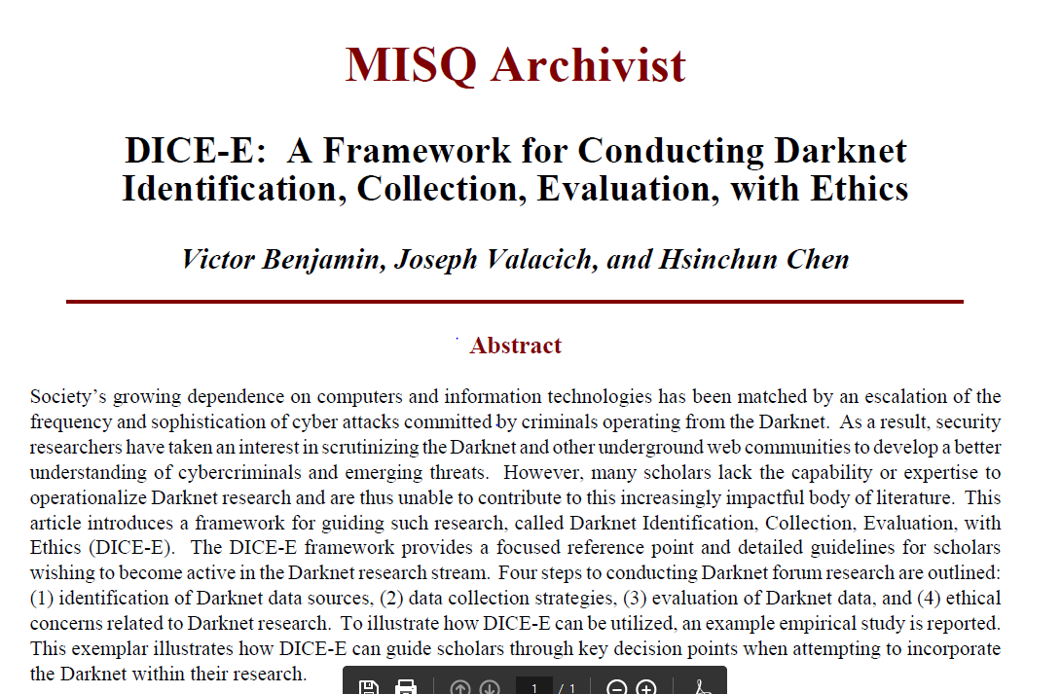
Identifying Key Hackers (Benjamin, et al., MISQ, Forthcoming)

Slide 30
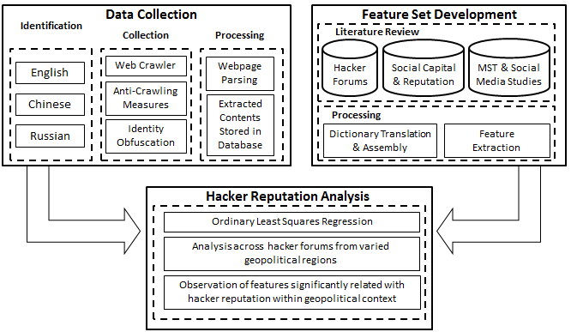
Hacker Reputation Framework

Slide 31
Category | Feature | Description | Feature Justification
Forum Content Features | Attachment of cybercriminal assets to forum posts | Forum participants sometimes attach cybercriminal assets to their forum posts. These include written & video tutorials, hacking tools, cracked software, etc. | Social Capital Theory - Attaching cybercriminal assets to posts can be considered as contribution of knowledge to community, increasing social capital.
 | Embedding of source code within forum posts | Hackers sometimes share source code for tools, malware, etc. by embedding them directly into forum posts | Social Capital Theory – Embedding source code be considered as contribution of knowledge to community, increasing social capital.
 | Discussion of Attack Vectors and Hacking Concepts | Demonstrates participant proficiency; Examples: Rootkit, XSS, SQL Injection, DDoS, shellcode, PoC, drive-by | Social Capital Theory - Sharing knowledge of attack vectors may increase social capital, as information can be helpful to other forum participants
 | Discussion of Programming and other Technical Concepts | Demonstrates participant proficiency; Examples: SQL, C++, ASM, .Net, XML | Social Capital Theory - Sharing knowledge of programming may increase social capital as it is a unique skill, as information can be helpful to other forum participants
 | Reputation System Scores | Peer-evaluated hacker reputation; reputation is not uniform across forums, i.e. a participant with good reputation in one forum may not necessarily have good reputation in another | Social Capital Theory - Reputation is explicitly mentioned as a potential result of increased social capital. Reputation systems are widely used by hacker communities.
Forum Usage Features | Media Symbols | Font color, font style, text bolding, italics, etc. | Media Synchronicity Theory – According to MST, increased usage of media symbols can lead to increased communication effectiveness
 | Threads Participated In | The number of threads a participant has participated in. | Common metric used frequently in prior social media and hacker forum research. Additionally, previous studies cite participate activity level as a factor for increasing reputation
 | Amount of Threads Started | The number of threads a forum participant has started | Common metric used frequently in prior social media and hacker forum research. Additionally, previous studies cite participate activity level as a factor for increasing reputation
 | Number of Posts Made | The number of posts a forum participant has made | Common metric used frequently in prior social media and hacker forum research. Additionally, previous studies cite participate activity level as a factor for increasing reputation
 | Seniority | The number of days a forum participant has belonged to a forum | Common metric used frequently in prior social media and hacker forum research. Additionally, previous studies cite participate activity level as a factor for increasing reputation

Slide 32
Hacker Reputation – Testbed
Forum Name | Language | # of Messages | # of Users | Forum Start Date | Forum End Date
Antichat.ru | Russian | 232,920 | 19,865 | 01-01-2003 | 1-2-2015
Ashiyane.org | Persian | 12,903 | 2,922 | 08-26-2008 | 1-2-2015
HackHound.org | English | 6,011 | 817 | 10-12-2012 | 1-2-2015
Unpack.cn | Chinese | 646,494 | 22,743 | 11-12-2004 | 1-2-2015

Slide 33
Hacker Reputation – Results
 | Antichat (Russia) |  | Ashiyane (Iran) |  | Hackhound (U.S.) |  | Unpack (China)
 | Estimate | P-value | Estimate | P-value | Estimate | P-value | Estimate | P-value
 | H1 Contribution of Knowledge and Cybercriminal Assets
Attachments | 0.0275 | 0.0062** | 0.0235 | 0.0472* | 0.1104 | 0.0074** | 0.0073 | 0.0181*
Embedded | 0.0194 | 0.0150* | 0.0149 | 0.0342* | 0.0286 | 0.0456* | 0.0151 | 0.0021**
Tech_Terms | 0.0106 | 0.5517 | -0.0106 | -0.0023 | 0.1332 | 0.1657 | -0.0005 | 0.2822
Hack_Terms | -0.0149 | 0.4928 | 0.0049 | -0.073 | 0.2745 | 0.1804 | 0.0164 | 0.533
 | H2. Forum Usage Behaviors
Msg_Symbols | 0.0323 | 0.0291* | 0.0224 | 0.032* | 0.0005 | 0.1222 | 0.0018 | 0.1232
Threads_Started | -0.023 | 0.6956 | -0.0049 | -0.0049 | -0.00001 | 0.1801 | -0.0043 | 0.9054
Seniority | 0.0032 | 0.8222 | -0.0048 | 0.9976 | -0.0003 | 0.8151 | -0.0280 | 0.4190
Total_Posts | 0.0145 | 0.0024** | 0.0249 | 0.0082** | 0.0164 | 0.0023** | 0.0343 | 0.0026**
 | H3. Forum Similarity Across Geopolitical Regions
Geo-location | 0.0032 | 0.8222 | -0.0048 | 0.9976 | -0.0003 | 0.8151 | 0.0018 | 0.4190
 | Signif. Codes. ‘**’<0.01, ‘*’<0.05
R² | 0.3184 |  | 0.4131 |  | 0.6299 |  | 0.3460

Slide 34
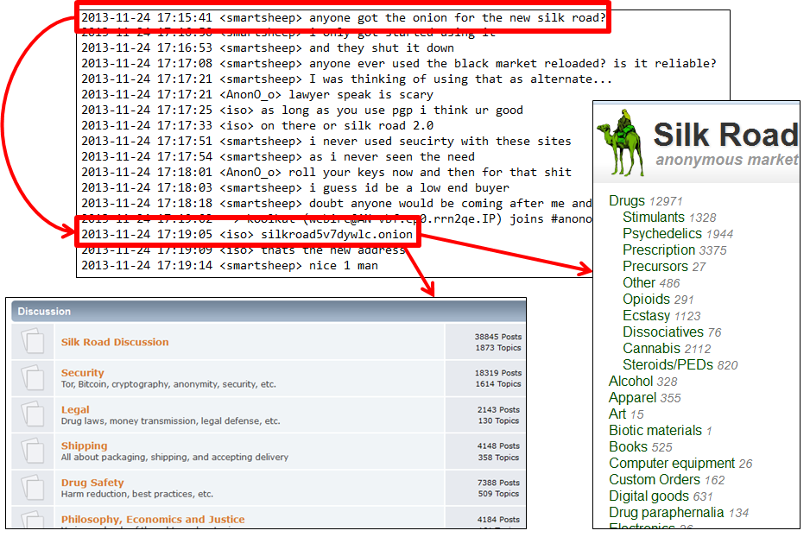
Hacker IRC Analytics

Slide 35
Hacker Participation – IRC Collection
Server | Channel | # of Users | # of Messages | Start Date | End Date
irc.anonops.org | #anonops | 5,311 | 314,039 | 11/31/13 | 10/31/14
irc.evilzone.org | #evilzone | 1,059 | 149,031 | 11/31/13 | 10/31/14

Slide 36
Hacker Participation - Feature Representation
Category | Feature | Model Designation | Feature Justification | Source
Network Features | Total Direct Addresses | DirectAddressOut | Direct addressing is common in IRC channels and is an indicator of network ties. Individuals that commonly direct address others may feel interconnected and participate often. | Garas et al., 2012; Sinha & Rajasingh, 2014
 | Total Times Addressed Directly | DirectAddressIn | Similarly, being addressed directly may increase feelings of interconnectedness within a network and lead to increased participation | Garas et al., 2012; Sinha & Rajasingh, 2014
 | Total Different Individuals Directly Addressed | UniqueAddressOut | We also consider the total number of unique individuals addressed, helping measure the total social interconnectedness of each participant in our channel | Garas et al., 2012; Sinha & Rajasingh, 2014
 | Total Times Directly Addressed by Different Individuals | UniqueAddressIn | The total number of times directly addressed by different individuals indicates the in-degree of social interconnectedness, which may lead to increased participation | Garas et al., 2012; Sinha & Rajasingh, 2014
Text Content Features | Total Message Volume | MsgVolume | Message volume is a commonly used indicator of participation rate, especially in the IRC context. | Motoyama et al., 2011; Benjamn & Chen, 2012
 | Total Num. of Hacking Messages | HackMsgs | Demonstrates hacking proficiency, which may indicate increased participation; Examples: Rootkit, XSS, SQL Injection, DDoS, shellcode, PoC | Holt & Lampke, 2010; Yip et al., 2013
 | Total Num. of Technical Messages | TechMsgs | Demonstrates technical proficiency, which may indicate increased participation; Examples: SQL, C++, ASM, .Net, XML | Holt & Lampke, 2010; Benjamn & Chen, 2012
 | Total Num. of Black Market Messages | MarketMsgs | Demonstrates market activity, perhaps indicating to increased participation for black market purposes Examples: Bitcoin, E-Gold, WebMoney | Radianti et al., 2009; Holt & Kilger, 2012
 | Hyperlinks Shared | Hyperlinks | Sharing of cybercriminal or technical resources, knowledge, or other information pertinent to community participants. May indicate to greater investment of time and participation. | Radianti, 2010; Benjamin & Chen, 2012
 | Deep Web Hidden Services Shared | HiddenServices | Sharing of deep web hidden services, pertinent to community participants. May indicate to greater investment of time and participation. | Martin, 2013

Slide 37
Hacker Participation - Results
Extended Cox’s Model Covariate Significance:
Feature | #Anonops |  | #Evilzone
 | Coef | P-Value | Coef | P-Value
MsgVolume | 0.0005 | 0.3564 | -0.00004 | 0.8948
HackMsgs | 0.0043 | 0.8130 | 0.01913 | 0.23201
TechMsgs | -0.0106 | 0.4928 | -0.00626 | 0.55172
MarketMsgs | 0.0049 | 0.1474 | 0.04713 | 0.52742
Hyperlinks | 0.0018 | 0.4190 | -0.00002 | 0.99863
HiddenServices | -0.0043 | 0.9054 | -0.07220 | 0.83614
DirectAddressOut | -0.0003 | 0.8151 | 0.00077 | 0.57525
DirectAddressIn | 0.00001 | 0.1801 | 0.0005 | 0.13126
UniqueAddressOut | 0.0164 | 0.00005 ** | 0.02985 | 0.00342 **
UniqueAddressIn | 0.0005 | 0.0222 * | 0.01092 | 0.4718 *
Signif. codes: ‘**’ 0.01, ‘*’ 0.05
#Anonops R² = 0.219
#Evilzone R² = 0.265

Slide 38
Hacker Participation – Case Example
Sampling of Longest Participating Users in our dataset:
Participant #3 from our table, I**y, is one of the most active participants of #Anonops
Involved in cybercriminal campaign for environmental hacktivism
Campaign named #OperationGreenRights
 | Username | Time Spells Participated | UniqueAddressIn | UniqueAddressOut
1 | P**e | 25 | 233 | 155
2 | M**t | 25 | 527 | 139
3 | I**y | 25 | 380 | 336
4 | T**t | 25 | 671 | 250
5 | B**h | 25 | 719 | 287

Slide 39
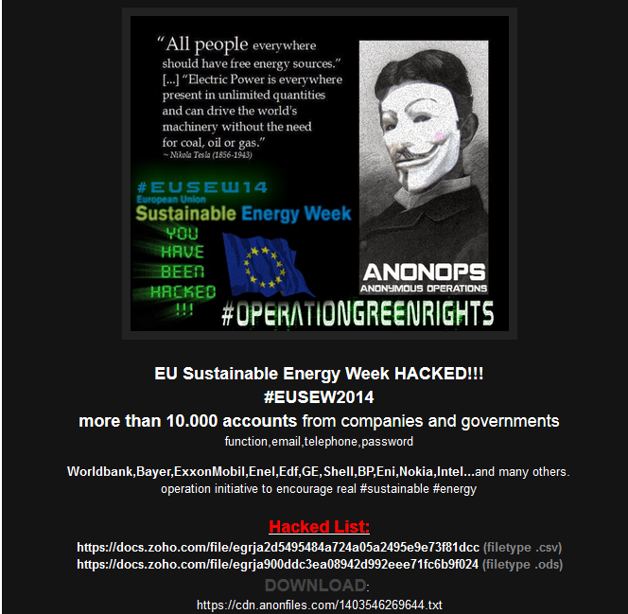
Hacker Participation – Case Example
Operation Announcement
Potential Targets
Leaked Data Dumps
Hackers claim to have stolen over 10,000 accounts from various companies and governments, including Worldbank, Bayer, ExxonMobil, GE, Shell, Nokia, Intel, and more.

Slide 40
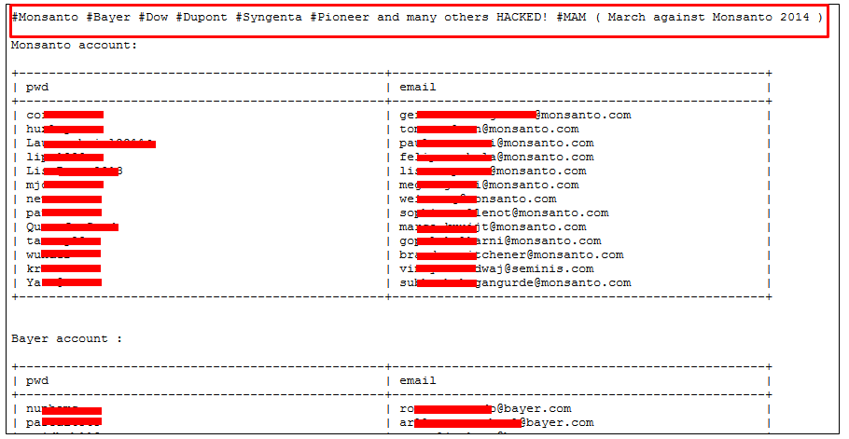
Hacker Participation – Case Example
A hacktivist operation against Monsanto, Bayer, Dow, Dupont, Syngenta, Pioneer, and others for environmental reasons. Over 1,800 compromised e-mail addresses and passwords are leaked.

Slide 41
Identifying Key Sellers (Li et al., JMIS, 2017)

Slide 42
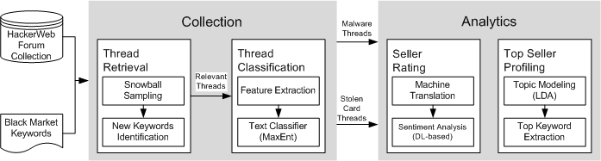
Hacker Sentiment Analysis Framework: “Honor Among Thieves?”
Figure 1. The AZSecure Text Mining Research Framework
Notes:
CLCTN: extract ads of diff type→who’s selling what
ANAL: ID and profile
TR: gen inclusive subset of UE threads and rule out irrelevant threads→classification efficiency
TC: dethermine if ad, what prod/serv; MaxEnt (Y?); features
SR: eval seller measuring CF
TSP: seller char TOPM
The framework comprises two steps: the collection step and the analytics step.
The collection step extracts advertisements and group them based on the product/type. It has two components: (1) thread retrieval and (2) thread classification.
(mouse) From a comprehensive collection of hacker forum discussions, thread retrieval identifies a subset of threads involving hacker forum users interested in the underground economy topics.
(mouse) The threads are classified to determine whether they are advertisement threads or not, and more specifically, if they are advertisement threads, what product/service they are promoting.
The analytics step analyzes the advertisements as well as associated customer feedback to evaluate and profile the seller. It has two components: (3) seller rating and (4) top seller profiling.
(mouse) Given advertisements of different categories of products/services, we can identify the specialty of the sellers and further evaluate their quality. Sellers are rated separately based on the replies to the thread.
(mouse) Top rated sellers are then profiled using topic modeling approach.
Given the significance of malware seller and stolen data seller, the scope of the research focuses on these two groups of sellers. Nonetheless, our framework is generalizable to capture sellers with other specialties.
In the reminder of this section, we elaborate each component in the framework.

Slide 43
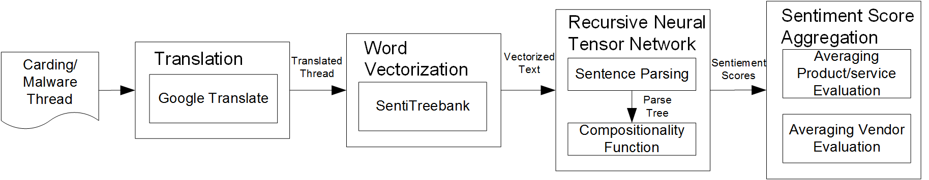
Recursive Neural Network Example – Identifying Key Carding Sellers

Slide 44
Recursive Neural Network Example – Identifying Key Carding Sellers
Example feedback: “The dump is not very good”
Recursive Neural Tensor Network
Compositionality function
Phrase Output
The additional tensor layer makes the compositional function more powerful by introducing the product of the constituent word embeddings.
compositionality function
Product term
Linear term
Word embeddings trained by SentiTreeBank
Output of the example feedback: Negative

Slide 45
Research Testbed
Table 2. Summary of the Carding Forums
Forum | Date Range | Members | Threads | Posts | Language | Type
Cardersforum | 5/12/2012 – 10/7/2014 | 4,168 | 7,890 | 20,081 | English | Carding
CrdPro | 5/30/2005 – 10/17/2014 | 27,607 | 70,302 | 679,893 | English/ Russian | Carding
Carderscave | 8/7/2013 – 11/2/2014 | 1,181 | 1,052 | 6,008 | English | Carding
Zloy | 3/8/2000 – 9/26/2014 | 13,572 | 49,617 | 395,530 | Russian | Forum with Black Market
Xakepok | 4/15/2009 – 9/10/2014 | 3,949 | 12,010 | 47,433 | Russian | Forum with Black Market
Exploit.in | 2/26/2005 – 10/26/2014 | 7,114 | 15,028 | 145,046 | Russian | Forum with Black Market
XekSecurity | 6/13/2007-9/8/2013 | 14,732 | 39,240 | 50,594 | Russian | Forum with Black Market
Antichat | 1/1/2003 – 8/19/2013 | 25,500 | 19,515 | 201,959 | Russian | Forum with Black Market
Major underground economy forums recommended by cybersecurity experts
Mostly east Europe forums
Notes:
The research testbed encompassing 8 forum-based underground economies recommended by our cybersecurity expert was collected.
They are mostly in Russian.
A couple of them are in English.
They are either dedicated carding forums or hacker forums with black markets.
These carding forums are mostly equipped with sophisticated anticrawling measures. To collect them, we leveraged multiple counter measures, including automated authentication, cookie installation, concealing request origin, etc. To verify the data integrity of our collection, we randomly sampled 20 threads and manually compare them against online data.

Slide 46
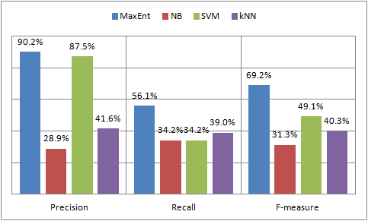
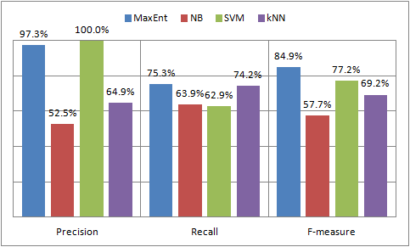
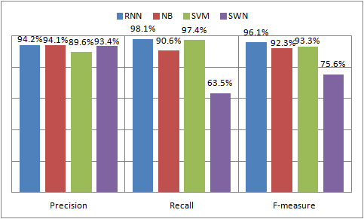
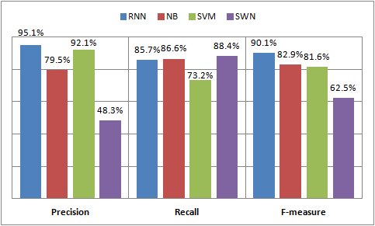
(a) Malware Advertisements
(b) Stolen Data Advertisements
Figure 2. Thread Classification Performance
(a) Positive Sentiment
(b) Negative Sentiment
Figure 3. Seller Rating Performance

Slide 47
Case Study: Key Seller Identification
Table 3. Top 3 Best/Worst Malware and Stolen Data Sellers for Each Forum
 | Top 3 Best |  |  |  | Top 3 Worst
 | Malware |  | Stolen Data |  | Malware |  | Stolen Data
Rank | User | Score | User | Score | User | Score | User | Score
 | Antichat
1 | LEOnidUKG | 5 | inferno[DGT] | 3.6 | @NoFrag@ | 1.8 | Isis | 2.3
2 | VISMU | 4.5 | amorales | 3.5 | k0lbasa | 2 | PEPSICOLA | 2.3
3 | gogol | 4 | «DEXTER» | 3.4 | Doktor_radosti | 2 | sultan128 | 2.4
 | CrdPro
1 | HackingAll | 4 | Rescator | 4.4 | N1K70 | 2 | finu2004 | 1.3
2 | balt | 4 | Faaxxx | 4 | 1vanu4 | 2 | sonny13 | 1.3
3 | SunSeller | 4 | ResellerInc | 4 | MID | 2 | l33tsu | 1.3
 | Zloy
1 | PerfectCrypt | 5 | BigBuyer | 4 | root | 1.5 | riodetray | 1
2 | DiXakMan | 4 | Buyers11 | 4 | w370w370 | 1.6 | madman | 1
3 | DjVellf | 4 | sellcc | 4 | gorpen | 2 | jekaa | 2
The malware seller generally tended to have higher ratings than stolen data sellers.
Some forums had better rated sellers than others.
All three forums had equally fraudulent malware sellers and stolen data sellers.
Notes:
We used the seller rating component in our framework to assign the quality measure to each seller and then identify the key sellers. The 3 best rated sellers and the 3 worst rated sellers for three of the forums are listed in Table 8.
Three findings can be drawn from comparing these malware and stolen data sellers for all three forums.
First, some forums had better rated sellers than others. CrdPro did not have as highly rated sellers of both malware and stolen data as the other two forums. Zloy had the best stolen data sellers among the three forums.
Second, the malware seller generally tended to have higher ratings than stolen data sellers for all three forums. This phenomenon is attributable to the property of the goods they are selling. The quality of malware is easier to determine than that of carding information. It is not easy for carders to guarantee the validity of each carding record.
Third, all three forums had equally fraudulent malware sellers and stolen data sellers. This means that although different measures of regulation had been enforced in each forum, fraudulent sellers existed universally across these underground economies.

Slide 48
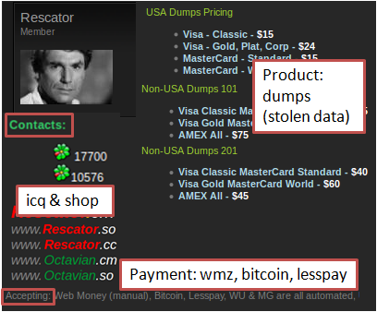
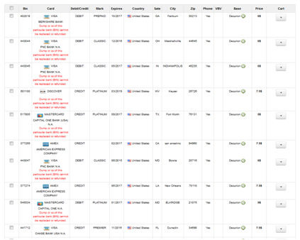
Case Study: Key Seller Profiling (LDA)
Table 4. Top Seller Characteristics of Rescator
# | Top Keywords | Interpretation
5 | shop, wmz, icq, webmoney, price, dump, | Product: CCs, dumps (valid, verified); Payment: wmz, webmoney, bitcoin, lesspay; Contact: shop, register, deposit, email, icq, jabber
6 | валид(valid), чекер(checker), карты(cards), баланс(balance), карт(cards)
8 | shop, good, CCs, bases, update, cards, bitcoin, webmoney, validity, lesspay
11 | dollars, dumps, deposit, payment, sell, online, verified
16 | email, shop, register, icq, account, jabber,
Figure 4. Illustration of Seller Characteristics:
(a) seller characteristics reflected from Rescator’s advertisement; (b) Rescator’s carding shop
(a)
(b)
Notes:
The following example shows the utility of using the top seller profiling component.
The example relates to one of the top carding sellers that we have identified previously, Rescator from CrdPro.
The seller is famous for distributing stolen data from more than one incident in the past twelve months, including the Target breach.
Table 7 shows the top 5 seller characteristics of this seller.
Each seller characteristic is represented by the top keywords in terms of the probability.
For example, seller characteristic 5 is depicted by “shop,” “wmz (short for webmoney),” “icq,” and “dump.”
Apparently, this seller characteristic bears multiple semantics, suggesting that the seller might run a carding shop selling dump, accept webmoney, and use icq as contact.
Based on the top keywords from each seller characteristic, we profile the sellers in terms of three perspectives.
Rescator sells mostly CC (credit card) and dumps (card magnetic strip) through the shop that requires deposit and registration or email/icq/jabber and accepts mainly webmoney, Bitcoin, and lesspay.
To verify the findings from top seller profiling regarding Rescator, we empirically found out the seller’s advertisement in the underground economy.
We show the essence of the advertisement in Figure 6a.
Apparently, the findings from the original advertisement match our profiling in general.
Furthermore, we were able to locate Rescator’s shop through the link provided (Table 6b), where we found millions of stolen payment cards for sale.

Slide 49
Type | Attribute | Description
Card | BIN | Bank Identification Number, the first 6 digits of the card number
 | Card type | personal/business card; visa/master/amex/discover; classic/standard/platinum/gold/signature
 | Expires | The expiration date of the card.
 | Issuer | The financial institute that issued the card
Source | Base | An arbitrary name assigned to a unique batch of cards from a breach.
 | Quantity | The quantity of stolen cards with a certain BIN.
 | Location | Location where the card information got skimmed, including country, state, city
 | Zip Code | Zip code corresponding to the location
Price | Price | Selling price of the CC/dump
Table 6. Card Metadata in Carding Shops
Carding shop | Products | Date | Collected Listings | Location Level
Rescator | CC&Dump | 2/6/2015 | 9,055 | Zip
Galaxycvv | CC&Dump | 2/6/2015 | 32,755 | City
cvv-store.su | CC | 2/6/2015 | 31,573 | Country
source4dumps | Dump | 2/6/2015 | 189,132 | Country
Table 7. Summary of the carding shops that we are monitoring

Slide 50
A Novel Topic Model for Textual Customer Reviews: Applications in E-Commerce and Hacker Underground Economy (IEEE TKDE, 2018)
Weifeng Lin
Notes:
screen shots of HUE as second slide

Slide 51
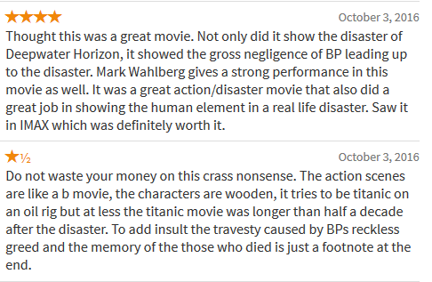

Multifaceted Customer Reviews
Bimodal-distributed ratings: convey little information for consumers to make decisions
Salient topics from textual movie reviews:
Genre
Theme
Character
Plot
Environment
Rotten Tomatoes Movie Reviews for Deepwater Horizon
Notes:
movie screenhsot
move forward
why topic modeling?
let them understand the problem
preview results

Slide 52









Latent Dirichlet Allocation (LDA) Intuition
“POS Skimmer for sale”
$K$ topics
Topic Proportion
$$θ_{d}$$
$$β_{1}$$
pos 0.04
skimmer 0.02
encrypt 0.01
Customer Reviews
New pos models good price and fast delivery!! up
Alkatron, i am satisfied with the device but i did sent you a msg about encrypted data to inbox 1 day ago please help me my questions check inbox!!thanks
Fast service! Droped Prices , Amazing offers with New MODELS ! Serious Buyers Pm !
Customer Reviews
New pos models good price and fast delivery!! up
Alkatron, i am satisfied with the device but i did sent you a msg about encrypted data to inbox 1 day ago please help me my questions check inbox!!thanks
Fast service! Droped Prices , Amazing offers with New MODELS ! Serious Buyers Pm !
$$K$$
$$β_{2}$$
cvv 0.03
vbv 0.03
ssn 0.02
New
pos
models
$$β_{3}$$
model 0.03
device 0.01
machine 0.01
$$β_{4}$$
price 0.05
delivery 0.04
service 0.01
$$β_{5}$$
new 0.04
fast 0.02
quick 0.01
K=5
…
$$Z_{d,n}$$
Notes:
Move to the front
think about analogy

Slide 53

Graphical Representation of Latent Dirichlet Allocation (LDA)
Assumptions:
Each topic is a distribution of words.
Each document is a combination of topics.
Each word is from one of those topics.
Latent Topics
Per-document Topic Proportions
Per-word Topic
Observed Word
Topics
Latent variables
Observed data (e.g., documents)

Slide 54








From Topic Model to Supervised Topic Model (STM)
Documents
(e.g., reviews)
$K$ topics:
Responses
(e.g., sales, quality, satisfaction, etc.)
cvv 0.03
vbv 0.03
ssn 0.02
price 0.05
delivery 0.04
service 0.01
model 0.03
device 0.01
machine 0.01
pos 0.04
skimmer 0.02
encrypt 0.01
picture 0.04
video 0.02
tutorial 0.01
Descriptive
(unsupervised)
Predictive
(Supervised)
$w$
$$y$$
$$β_{1}$$
$$β_{2}$$
$$β_{3}$$
$$β_{4}$$
$$β_{5}$$
STM can simultaneously
Explore the underlying topics
Make predictions using the extracted topics
More accurate prediction by capturing the underlying topics shared across documents (Blei & Mcauliffe 2008)
Notes:
Existing STMs:
Supervised LDA, Dirichlet Multinomial Regression, Discriminative LDA, Dependency-LDA, Inverse Regression Topic Model (IRTM)…

Slide 55

From Topic Model to Supervised Topic Model (STM)
Latent Dirichlet Allocation (Blei et al. 2003)
Inverse Regression Topic Model (Rabinovich & Blei 2014)
Per-document Topic Proportions
Per-word Topic
Observed Word
Per-document Topic Proportions
Per-word Topic
Observed Word
Response
Topics
Topics
Coefficient
Left: topic model; Right: supervised topic model

Slide 56
Model Specifications:
Variable | Distribution | Description
 | Laplace distribution (Taddy 2013): | Coefficient of the response on word
 | Dirichlet Process (Teh et al. 2006): : distribution over topics | Corpus topic distribution Collection of all possible topics that will be used in the corpus
 | Dirichlet Process (Teh et al. 2006): | Document topic distribution Collection of all possible topics for the document
 | Multinomial distribution (Blei et al. 2003): | Topic of the -th word in the -th document
 | Multinomial distribution (Rabinovich & Blei 2014): | Observed -th word in the -th document
Hierarchical Dirichlet Process
Notes:
hide

Slide 57





Latent Dirichlet Allocation vs. Hierarchical Dirichlet Process
Latent Dirichlet Allocation
Hierarchical Dirichlet Process
Corpus-Level Topics
Corpus-Level Topics
Topics | 1 | 2 | 3 | 4 | 5
$∞$ Topics
Document 1 (Topic Prop.)
Topics | 1 | 2 | 3 | 4 | 5
Prop. | .1 | .2 | .1 | .4 | .2
Document 1
(Topic Dist.)
Document 2
(Topic Prop.)
Topics | 1 | 2 | 3 | 4 | 5
Prop. | .3 | .2 | .1 | .2 | .2
Document 2
(Topic Dist.)
……
……
Document D
(Topic Prop.)
Topics | 1 | 2 | 3 | 4 | 5
Prop. | .3 | .2 | .1 | .2 | .2
Document D
(Topic Dist.)

Slide 58













Model Inference: Intuition
$$G_{0}$$
“POS Skimmer for sale”
Service Quality: High
$∞$ topics
Topic Distribution
$$G_{d}$$
$$Φ$$
Customer Reviews
New pos models good price and fast delivery!! up
Alkatron, i am satisfied with the device but i did sent you a msg about encrypted data to inbox 1 day ago please help me my questions check inbox!!thanks
Fast service! Droped Prices , Amazing offers with New MODELS ! Serious Buyers Pm !
$$β_{d1}$$
$$β_{d2}$$
$$β_{d3}$$
$$β_{d4}$$
$$β_{d5}$$
$$β_{d6}$$
$$β_{d7}$$
$$β_{d8}$$
$$β_{d9}$$
…
Notes:
In reality, we only observe documents. The other structures are latent variables. Our goal is to infer the hidden variables.

Slide 59


Stochastic Variational Inference
Batch (Traditional) Inference
Stochastic Variational Inference
$$dε\{All Documents\}$$
$$dε\{Subsamples\}$$
E-step
M-step
E-step
M-step
Stochastic variational inference advantages (Hoffman 2013):
Reduced computational complexity for each update
Capable of processing large scale data (N>100K)

Slide 60
Evaluation Design
Evaluation #1
Evaluation #2
Objective: Whether topic modeling improves the prediction of textual customer reviews?
NSTM vs. state-of-the-art non-topic-based approaches
Baseline: Multinomial Inverse Regression (MNIR) (Taddy 2013); Support Vector Machine (SVM), Naïve Bayes (NB)
Objective: Whether the nonparametric technique improves the prediction of textual customer reviews?
NSTM vs. state-of-the-art parametric topic-based models
Baseline: supervised LDA (sLDA); Dirichlet Multinomial Regression (DMR)
Notes:
remove more words

Slide 61
Research Testbeds: From E-Commerce to Cybersecurity
Movie reviews
5,006 reviews with balanced numerical rating
Benchmark
Yelp reviews
330,071 reviews with numerical rating
Benchmark, balanced
Amazon reviews
1,422,518 reviews for over 20 categories of products
Benchmark
Hacker Underground Economy (HUE) reviews
English/Russian reviews for 2,000 data breach services
Two major data breach hacker forums (total: 32.5K members; 75K threads)
Cross domain
(Generalizability)
Notes:
Four different types of data
Evaluate model against all four sets: it is cross domain
Generalizabile across different domains

Slide 62


Evaluation 1: Whether modeling topics helps?
At least 4% improvement over closest technique
Better
Failed to converge
Failed to converge
Failed to converge
Failed to converge
Better
Failed to converge
Failed to converge
Better
Notes:
explain settings first
.

Slide 63

Evaluation 2: Whether the nonparametric technique helps?
At least 17% improvement over closest technique
Better
Failed to converge
Failed to converge
Failed to converge
Failed to converge
Better
Failed to converge
Failed to converge
Better

Slide 64



Application in Hacker Underground Economy
Goal: identify high quality data breach services
Approach: predicting service quality from textual customer reviews
Sample Customer Reviews
New pos models good price and fast delivery!! up
Alkatron, i am satisfied with the device but i did sent you a msg about encrypted data to inbox 1 day ago please help me my questions check inbox!!thanks
Fast service! Droped Prices , Amazing offers with New MODELS ! Serious Buyers Pm !
Infrastructure
Seller | Quality
Alkatron | ?
Nikkon | ?
alexbbr | ?
Data
Seller | Quality
Rescator | ?
McDumpal | ?
Nikkon | ?
Cashing
Seller | Quality
Nikkon | ?
ArtHouse | ?
devica | ?
Service
Reviews
Reviews
Service
Buyers
Service
Reviews
Color: latent semantic themes (i.e., topics) that are common across all reviews

Slide 65
Application in Hacker Underground Economy
Predicted service quality helps identify the key services in hacker underground economy.
Infrastructure
Seller | Quality
Alkatron | High
Nikkon | Medium
alexbbr | Low
Data
Seller | Quality
Rescator | High
McDumpal | High
Nikkon | Low
Cashing
Seller | Quality
Nikkon | High
ArtHouse | Medium
devica | Low
Service
Reviews
Reviews
Service
Buyers
Service
Reviews

Slide 66

Hacker Responsible for 2013 Target Breach
Description of the stolen data/service
Prices of the stolen data
Contact: a dedicated shop and ICQ
Payment Options

Slide 67

Rescator claims to have millions of such listings.

Slide 68







Finding: Shop Update Timeline
Shops:
Timeline for the Updates in the Carding Shops: We parallel the updates in shops with the data breach incidents over time. Before the discovery of data breach, bulks of breached data already appear in the market for sale

Slide 69
AZSecure Hacker Assets Portal: Proactive Cyber Threat Intelligence (Samtani, et al., JMIS 2017)

Slide 70
Introduction – Hacker Asset Examples
Figure 1. Forum post with source code to create botnets
Figure 2. Forum post with BlackPOS malware attachment
Figure 3. Tutorial on how to create malicious documents

Slide 71














AZSecure Hacker Assets Portal System Design and Features
Data Collection and Analytics
Web Hosting and Access
System Functionalities
Browsing
Searching
Downloading
System Analytics
Latent Dirichlet Allocation (LDA) and
Support Vector Machine (SVM) Analytics
987 tutorials, 15,576 source code, and
14,851 attachments
Cyber Threat Intelligence
Dashboard
VirusTotal Malware Analysis
Figure 5. AZSecure Hacker Assets Portal System Design and Features

Slide 72
AZSecure Hacker Assets Portal – Data Testbed
Forum | Language | Date Range | # of Posts | # of Members | # of source code | # of attachments | # of tutorials
OpenSC | English | 02/07/2005-02/21/2016 | 124,993 | 6,796 | 2,590 | 2,349 | 628
Xeksec | Russian | 07/07/2007- 9/15/2015 | 62,316 | 18,462 | 2,456 | - | 40
Ashiyane | Arabic | 5/30/2003 – 9/24/2016 | 34,247 | 6,406 | 5,958 | 10,086 | 80
tuts4you | English | 6/10/2006 – 10/31/2016 | 40,666 | 2,539 | - | 2,206 | 38
exelab | Russian | 8/25/2008 – 10/27/2016 | 328,477 | 13,289 | 4,572 | - | 628
Total: | - | 02/07/2005- 10/31/2016 | 590,699 | 47,492 | 15,576 | 14,851 | 987
Notes:
The Data Mining slide needs to have a system diagram, testbed, and validation results – some significant details to lend credibility.

Slide 73
AZSecure Hacker Assets Portal – Data Mining Approach
Algorithm | Accuracy | Precision | Recall | F1
SVM | 98.20 | 96.36 | 98.20 | 98.28
k-Nearest Neighbor | 64.00 | 83.47 | 64.00 | 72.24
Naïve Bayes | 86.00 | 88.57 | 86.00 | 87.26
Decision Tree | 82.60 | 86.41 | 82.60 | 84.42
Notes:
The Data Mining slide needs to have a system diagram, testbed, and validation results – some significant details to lend credibility.
Benchmarking in this fashion is a commonly accepted evaluation practice in computer science and related domains.

Slide 74





Hacker Assets Portal V2.0 – Overview
(a) Home page, linking to (b & c) Assets, (d) Dashboard, and (e) Malware Families:
(e) Malware Families, for depicting relationships among assets over time (Crypter Family shown)
(b) Assets page, linking to Source Code and Attachments
(c) Source Code page; sortable by asset name, exploit type, date, etc.
(d) Dashboard for drill-down analysis of hackers & assets over time

Slide 75


Cyber Threat Intelligence (CTI) Example – Bank Exploits
1
2
Filtering on 2014, when BlackPOS was posted, shows assets and threat actors at that time.
Filtering the actor who posted BlackPOS reveals that he posts other bank exploits (e.g., Zeus).
Provides intelligence on which hacker to monitor.

Slide 76


Cyber Threat Intelligence (CTI) Example – Mobile Malware
1
2
Filtering for 2016 mobile malware shows assets and threat actors at that time.
Filtering on a specific actor (BH-HACKER) allows us to see the assets posted.

Slide 77
Identifying Hacker’s Targets for Proactive Cyber Threat Intelligence: A Deep Structured Semantic Model Approach (MISQ, under review)
Sagar Samtani

Slide 78
Research Design
Figure 9. Research Design for Exploit-Vulnerability Linkages

Slide 79
Research Design – Exploit-Vulnerability Linkages: EV-DSSM
Algorithm 1: Exploit-Vulnerability DSSM (EV-DSSM)
Input: exploit list E = {e₁, e₂, …, e_{n}} and vuln. list V = {v₁, v₂, … v_{n}} Output: a list of tuples, [(e_{k1}, v₁), (e_{k2}, v₂), …] where e_{ki}ϵE, v_{i}ϵV (i = 1, 2, …, n) output = [] Initialization for v_{i} ϵ V (i = 1, 2, …, n): for e_{j} ϵ E (j = 1, 2, …, n): if v_{i}.vuln_ver in e_{j}.post_content: v_{i}.title = concat(v_{i}.title, v_{i}.vuln_ver) e_{j}.title = concat(e_{j}.title, v_{i}.vuln_ver) else: do nothing sem_embed_v_{i} = semantic_embed_with_DSSM(v_{i}.title) sem_embed_e_{j} = semantic_embed_with_DSSM(e_{j}.title) sim_{ij} = cosine_similarity(sem_embed_v_{i}, sem_embed_e_{j}) end for k_{i} = argmax_{j}(sim_{ij}) output.append((e_{ki}, v_{i})) end for return output
Figure 10. EV-DSSM example. If there is a match between one of the vulnerable
versions in the vulnerability description and the post content, then the version name
is appended to both the vulnerability name and exploit names before being hashed.
Intuitively, this will increase the similarity between the exploit and vulnerability.

Slide 80
Results and Discussion – DSSM Evaluations
Method | NDCG@1 | NDCG@3 | NDCG@10
EV-DSSM | .397* | .428* | .452*
DSSM | .376 | .406 | .439
TF-IDF | .363 | .395 | .418
BM25 | .306 | .359 | .399
WTM | .321 | .329 | .346
LSA | .298 | .305 | .356
Table 10 and Figure 11 summarize evaluation results.
Overall, EV-DSSM significantly outperforms the standard DSSM at all NDCG levels.
Indicates that EV-DSSM benefits from including contextual features for linkages rather than just using vulnerability and exploit names.
Additionally, the EV-DSSM significantly outperforms all baseline methods in NDCG.
Table 10. DSSM Benchmark Evaluations
*indicates statistically significant improvements over other methods
Figure 11. DSSM Benchmark Evaluations

Slide 81






Case Studies: SCADA and Hospitals
20,461 SCADA Devices from major vendors (e.g., Rockwell)
Motivation: SCADA → control critical infrastructure
1,879 devices from top 8 US hospitals
Motivation: Hospitals → popular target for hackers
Procedure
Device
Identification
Vulnerability
Scanning
EV-DSSM
DVSM

Slide 82

Selected Case Study Results
Hospital Device Information |  | Device Severity Score Information for Selected Devices
Hospital Name | # of Vulnerable Devices/# of devices | Device Type | # of Vulnerabilities | Vulnerabilities | DVSM
12x.x.x.x | 133/808 | FTP/SSH Server | 3 | FTP issues | 3.233
19x.x.x.x | 27/301 | SSH Server | 3 | SSH issues | 3.193
17x.x.x.x | 31/274 | eCare web portal | 47 | XSS, OpenSSL, buffer overflow, DoS | 56.398
16x.x.x.x | 59/160 | Medical computing portal | 5 | PHP and SSH issues | 4.863
14x.x.x.x | 64/130 | Web Server | 3 | SQL Injections | 8.009
 |  | Apple TV | 2 | Buffer overflow | 6.909
14x.x.x.x | 14/107 | SSH/Web server | 4 | PHP and SSH issues | 4.088
6x.x.x.x | 9/52 | Informational diabetes portal | 3 | SVN and Unix vulnerabilities | 6.616
16x.x.x.x | 7/47 | Web Server | 6 | XSS, HTMLi | 8.233
Total: | 344/1,879 (18.31%) | - | - | - | -
Portals are a common avenue for hackers to access sensitive records (Ayala 2016).
Analysis shows an eCare portal with a large attack surface: 47 vulnerabilities for a DVSM of 56.398.
Network admins can prioritize this device when analyzing their weaknesses.
Selected devices for each hospital
Vulnerability Name (CVSS Score) | Exploit Name (Post Date) | Severity Score
“OpenSSL Unsupported” (10.0) | “SSL Poodle” (10/14/2014) | 3.352
“Multiple XSS Vulnerabilities” (4.3) | “XSS Lab” (7/27/2015) | 1.519
… | … | …
- | - | Total: 56.398
Notes:
344/1,879 (18.31%) devices have vulnerabilities (176 with multiple, 168 with one).
Various SQL, SSH, PHP, OpenSSL, and Unix issues
Portals are a common avenue for hackers to access sensitive records (Ayala 2016).
Analysis shows an eCare portal with a large attack surface: 47 vulnerabilities for a DVSM of 56.398.
Network admins can prioritize this device when analyzing their weaknesses.

Slide 83
Identifying Key Hackers and Hacker Communities: A Graph Convolutional Autoencoder (GCAE) Approach
Sagar Samtani

Slide 84
Hackers and Hacker Assets
Tutorial on how to create
malicious documents
Forum post with source code to
exploit Mozilla Firefox 3.5.3
Forum post with
BlackPOS malware attachment.

Slide 85
Literature Review - GCNs
Year | Author | Dataset(s) | Task | Network Nodes | Node Attributes
2018 | Chen et al. | Cora, Pubmed, Reddit | Node classification | Documents | Term frequencies
2017 | Manessi et al. | DBLP | Node classification | Authors | # of articles published
2017 | Kipf et al. | Cora, Citeseer, Pubmed | Link prediction | Documents | Term frequencies
2017 | Hamilton et al. | Citation, Reddit, PPI | Node classification | Documents | Term frequencies
2017 | Yasunaga et al. | Data Understanding Conferences Papers | Document classification | Sentences | Sentence embedding
2017 | Demeril | Brown Corpus | Part-of-Speech classification | Words | Word embedding
2017 | Kipf and Welling | Citeseer, Cora, Pubmed, Nell | Semi-supervised classification | Documents | Term frequencies
Selected Studies Using GCNs
Despite GCN’s breadth of applications, it is designed for supervised learning tasks.
Thus, the learned embeddings are task-specific; they are the most salient features that create the best mappings between the input data and pre-specified output labels.
Less suitable for and generalizable to other tasks (e.g., community detection).

Slide 86



Literature Review – GCN Formulation
Recognizing these issues, Kipf and Welling formulated f(X, A) to augment the standard ANN with graph convolution operations: $H^{l+1}=σ (\hat{A}{ H}^{\left(l\right)}W^{\left(l\right)})$
Graph Convolution Operations
$\hat{A}$ is the graph convolution. It can be decomposed into:
$${\tilde{D}}^{−\frac{1}{2}}\tilde{A}{\tilde{D}}^{−\frac{1}{2}}$$
Where:
$\tilde{A}$ is the identity matrix I_{N} + A (to prevent information loss)
D is the degree matrix (normalizes features to prevent scaling issues)
Note: $\hat{A}$ convolves around each node’s neighborhood to capture information, simulating the convolutions seen in a traditional CNN.
Neural Network Operations
$σ$ is the activation function, usually Rectified Linear Unit (ReLU)
H^{(l)} is the row-wise embedding of the graph nodes in the lth layer
W^{(l)} is the a weight parameter matrix (updated through backprop)
Value: Extract salient structural and nodal features to learn a pre-specified label without manual feature engineering.
Note: Selected literature using GCNs summarized in next slide.

Slide 87
Literature Review – Autoencoders
Step 1: Encoder “encodes” input data into a embedding using non-linear activation functions.
Each layer reduces dimensionality.
Step 2: Decoder reconstructs output by using non-linear layers to “decode” embedding.
Each layer increases dimensionality.
Step 3: Mean Squared Error (MSE) is calculated between the reconstructed output and original input.
Step 4: Error is backpropagated to adjust autoencoder weights.
Step 5: Steps 1-4 are repeated until MSE is minimized.
Figure 3. Autoencoder Architecture
Notes:
From left: Step 1 reduces dimensionality of inputted data until a bottleneck is reached.
Step 2 aims to reconstruct output from the bottlenecked representation.
Step 3 compares reconstructed output with original input.
Step 4 uses backpropagation to adjust autoencoder weights.
The process continues until error between output and input is minimized.

Slide 88
Research Design – GCAE Architecture (Novelty)
Contribution:
First method (to our knowledge) that learns an embedding integrating both high-dimensional nodal and structural features in an unsupervised manner.
Value:
Generated embedding can be used for multiple tasks.
Can be used in multiple social media contexts.
Novelty: Extension of standard autoencoder to incorporate graph convolutions,
as formulated by Kipf and Welling (2017)

Slide 89











Research Design
Data Collection and Pre-Processing
Network Representation
Graph Convolutional Autoencoder Construction
Key Hacker and Community Detection (Case Study)
Network Formulation
Forum Identification
Graph Convolutional
Autoencoder (GCAE)
Key Hacker Identification
Obfuscated Crawling
Descriptive Statistics
Data Pre-Processing
Exploit Degree Centrality (EDC)
Benchmark Experiments
Community Detection
Research Framework for Identifying Key Exploit Sharing Hackers and Communities

Slide 90
Results and Discussion – GCAE Experiment 1: GCAE vs Structural Embeddings
Embedding Approach | NMI | Homogeneity | Completeness | V-Measure
GCAE (3 layer, w/ features) | 57.81% | 51.78% | 65.57% | 57.86%
DeepWalk | 44.97%* | 41.45%* | 49.03%* | 44.92%*
Node2Vec | 44.51%* | 42.72%* | 46.43% | 44.50%*
GCAE (3 layer, w/o features) | 40.75%* | 34.80%* | 54.13%* | 42.36*
LINE | 22.36%* | 22.36%* | 23.35% | 22.84%*
GraRep | 22.31%* | 21.50%* | 23.56% | 22.48%*
GCAE Benchmark Evaluation Results
(* indicates statistically significant difference at p<0.05)
GCAE Benchmark Evaluation Results
GCAE outperformed all methods by statistically significant margins (V-measure: 57.86%).
DeepWalk and Node2Vec had similar V-Measures of 44.92% and 44.50%, respectively.
GCAE w/o attributes (42.36%) outperformed LINE (22.84%) and GraRep (22.48%).
Indicates that using textual nodal attributes significantly enhances community detection.
Previous studies only integrate selected categorical attributes or no nodal attributes (Jia et al. 2017).

Slide 91
Results and Discussion – GCAE Evaluation 2
GCAE Depth | GCAE Configuration | NMI | Homogeneity | Completeness | V-Measure
3 layer | GCAE | 57.81% | 51.78% | 65.57% | 57.86%
 | Sparse GCAE | 51.17% | 46.00% | 58.00% | 51.37%
 | Denoising GCAE | 54.08% | 52.41% | 55.89% | 54.09%
5 layer | GCAE | 49.46%* | 49.12%* | 49.80%* | 49.46%*
 | Sparse GCAE | 42.76%* | 41.63%* | 45.68%* | 43.56%*
 | Denoising GCAE | 44.09%* | 44.58%* | 46.90%* | 45.71%*
7 layer | GCAE | 39.81%* | 38.79%* | 40.94%* | 39.84%*
 | Sparse GCAE | 22.36%* | 21.67%* | 23.40%* | 22.50%*
 | Denoising GCAE | 26.75%* | 26.71%* | 26.79%* | 26.75%*
GCAE Architecture Evaluation Results (* indicates statistically significant difference at p<0.05)
Key Findings:
Standard GCAE outperformed sparse and denoising variations.
3 layer GCAE 57.86% V-measure; denoising GCAE 54.09% V-Measure; sparse GCAE 51.37% V-Measure
As GCAE depth increased, performance decreased (irrespective of architecture).
3 layer GCAE 57.86% V-measure; 5 layer GCAE 49.46% V-Measure; 7 layer GCAE 39.84% V-Measure

Slide 92
Research Design – Case Study
Case study illustrates GCAE’s and EDC’s practical utility.
One forum: 137,664 posts (2,720 exploits), 7,011 hackers, 2/7/2005 – 10/22/2017
Follows the steps CTI professionals and/or law enforcement can take.
Procedure
Construct Network
Descriptive Statistics
GCAE
EDC
Nodes → hackers in thread with exploit
Edges → from hackers posting exploit
Understand overall
network dynamics
Extract embeddings
to detect communities
(3 layer GCAE)
Identify key hackers
within communities
Notes:
Step 1: Construct network (nodes are hackers in th, edges )
Step 2: Calculate descriptive statistics to understand overall network dynamics
Step 3: Apply GCAE to extract embeddings for community detection
Step 4: Use EDC to identify key hackers within communities

Slide 93

Results and Discussion – Case Study Results
CTI professionals are also interested in groups of hackers based on their attack preferences.
K-means was used on GCAE embeddings to extract six communities.
656 nodes: rootkits, malware designed to control low level system processes such as memory dumps, etc.
639 nodes: botnets, software often used to conduct DDoS.
561 nodes: zombies, used to control computing resources on unsuspecting victim machines.
518 nodes: RATs, tools to control a system’s peripherals (e.g., webcam).
340 nodes: crypters, a core ransomware technology.
197 nodes: Zeus, an exploit designed for financial institutions.
Rootkits: 656 nodes
Botnets: 639 nodes
Zombies: 561 nodes
RATs: 518 nodes
Crypters: 340 nodes
Zeus Trojans: 197 nodes
Communities Identified Using GCAE Embeddings

Slide 94


AZSecure Cybersecurity Program: A University of Arizona SFS & SFI Program
AZSecure
University of Arizona
“Training the next generation of cybersecurity professionals”
https://msmis.eller.arizona.edu/azsecure-cybersecurity-fellowship-program

Slide 95


What is AZSecure?
“The West Point for Cybersecurity Education”
Program generously funded by National Science Foundation (NSF).
Designed to train the next generation of cybersecurity professionals.

Slide 96
AZSecure SFS Statistics
NSF Scholarship-for-Service: 50+ institutions, US citizens
AZSecure SFS, $6.5M, 2013-2018, 40+ MS/Ph.D. students; one of the largest and most advanced SFS programs
$140K-$250K for 2-3 years; $32K stipend for 9 months + paid interns + government jobs
MS in MIS courses + Information Assurance/Cybersecurity training/courses (NSA/DHS CAE + ECE/CS) + job fair/summer intern + faculty-supervised independent study/research for each semester + research publication + MS Thesis
Cybersecurity interest + MS education and research + government placement

Slide 97
Computational Design Science in MIS (AI Lab/UA): ➔High-impact Societal (data/IT) Problems ➔Mathematics/Statistics/Linguistics/Cognition ➔ Algorithms/Representations (e.g., intelligent IR/SE, SOM, text mining, multilingual stylometric/affect/sentiment analysis, HCI/Viz, LDA, Deep Learning) ➔ Programs/Systems ➔ Evaluation/Adoption/Deployment ➔ Societal Impact

Slide 98
My Lessons Learned (After 30 Years in AI/Design Science/Data Science): ➔Societal Impact > Academic Impact ➔ IT > MIS ➔ CISE > SBE ➔ New > Old ➔ EQ > IQ

Slide 99



For questions and comments
AI Lab @U.Arizona, 30 Years
hchen@eller.Arizona.edu
http://ai.Arizona.edu

